Slide 1
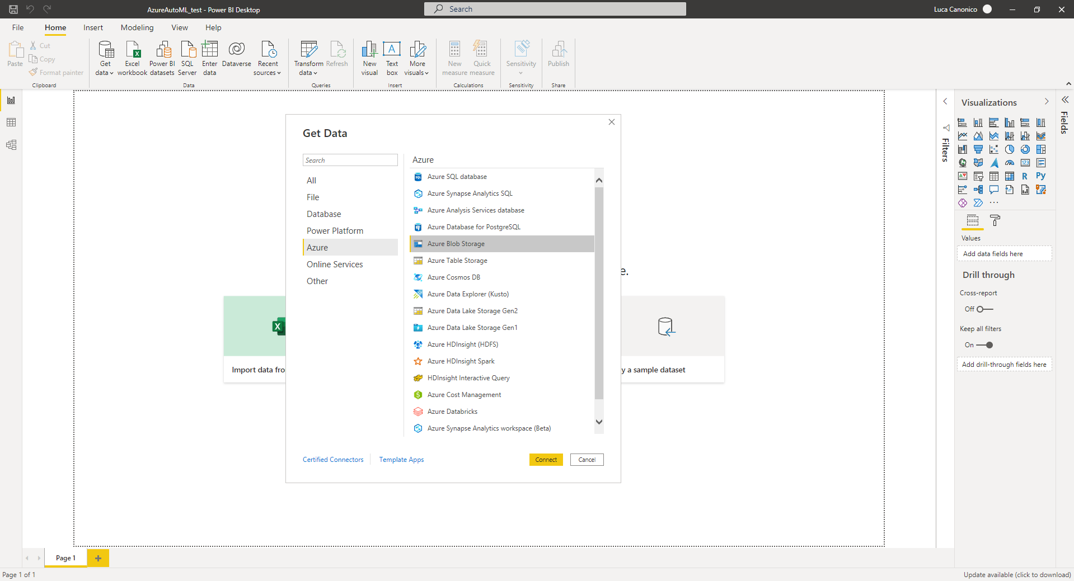
make prediction on new data stored in azure blob container

Slide 2
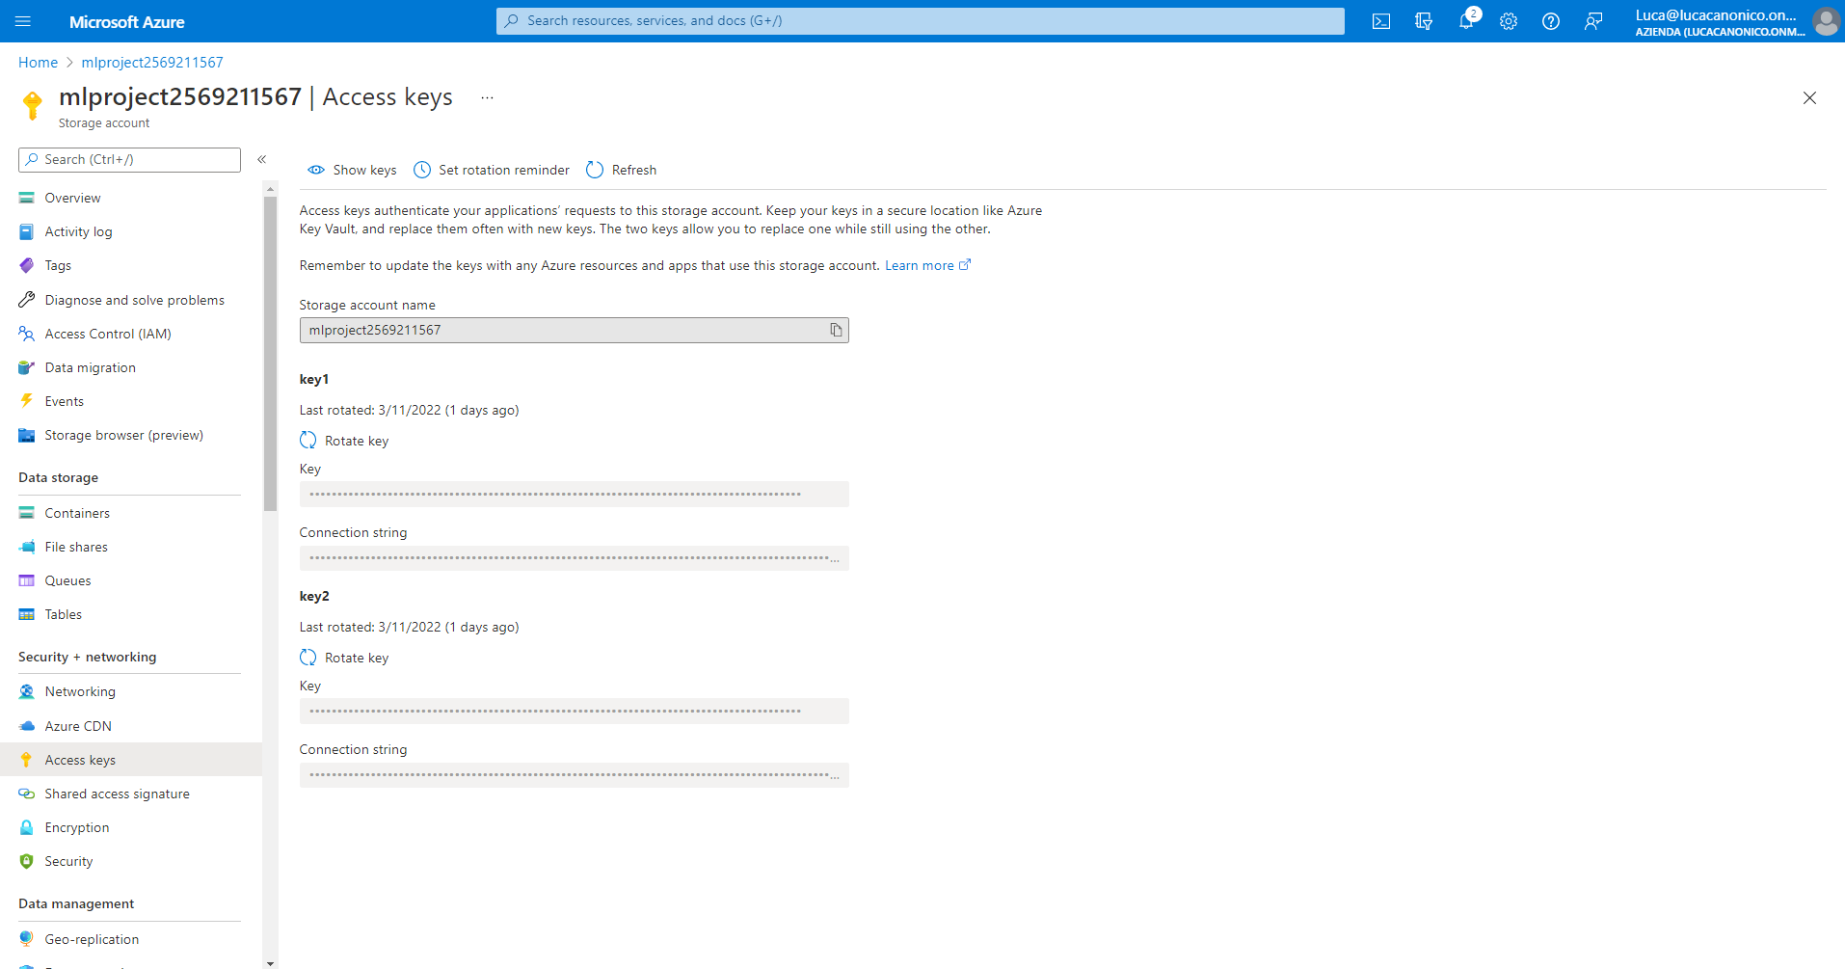
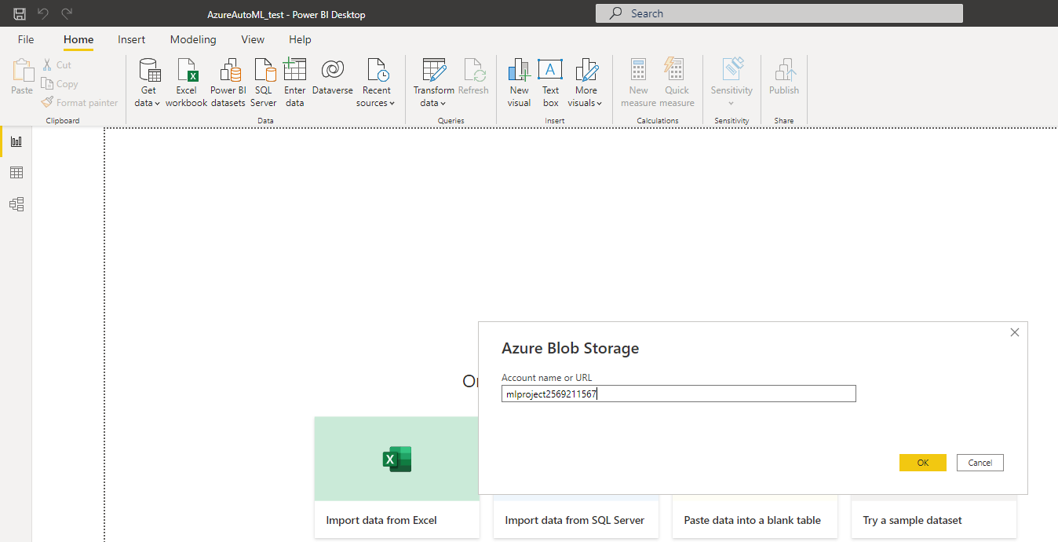
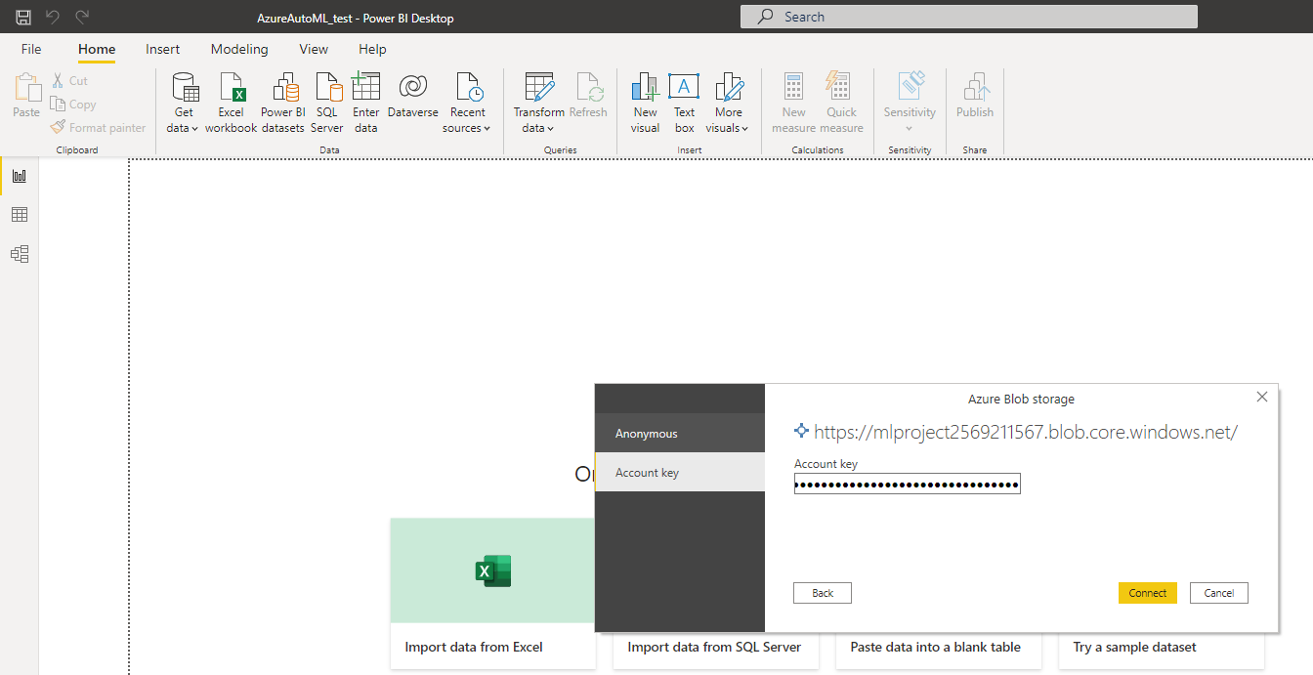
Go to your storage account > access keys and retrieve Storage account name and Key

Slide 3
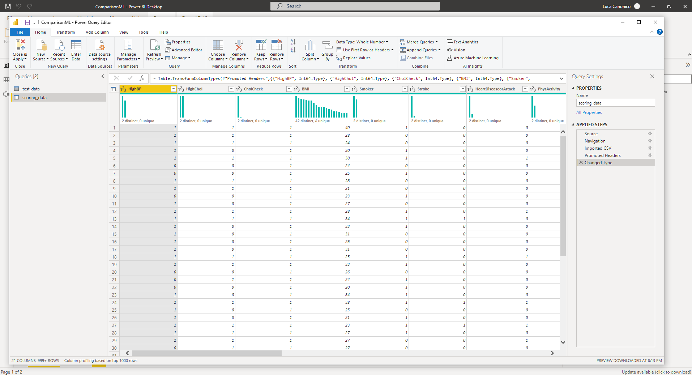
I’ve imported scoring_data (unlabeled data) on which make prediction and the test data used on Azure ML Studio to evaluate model after training

Slide 4
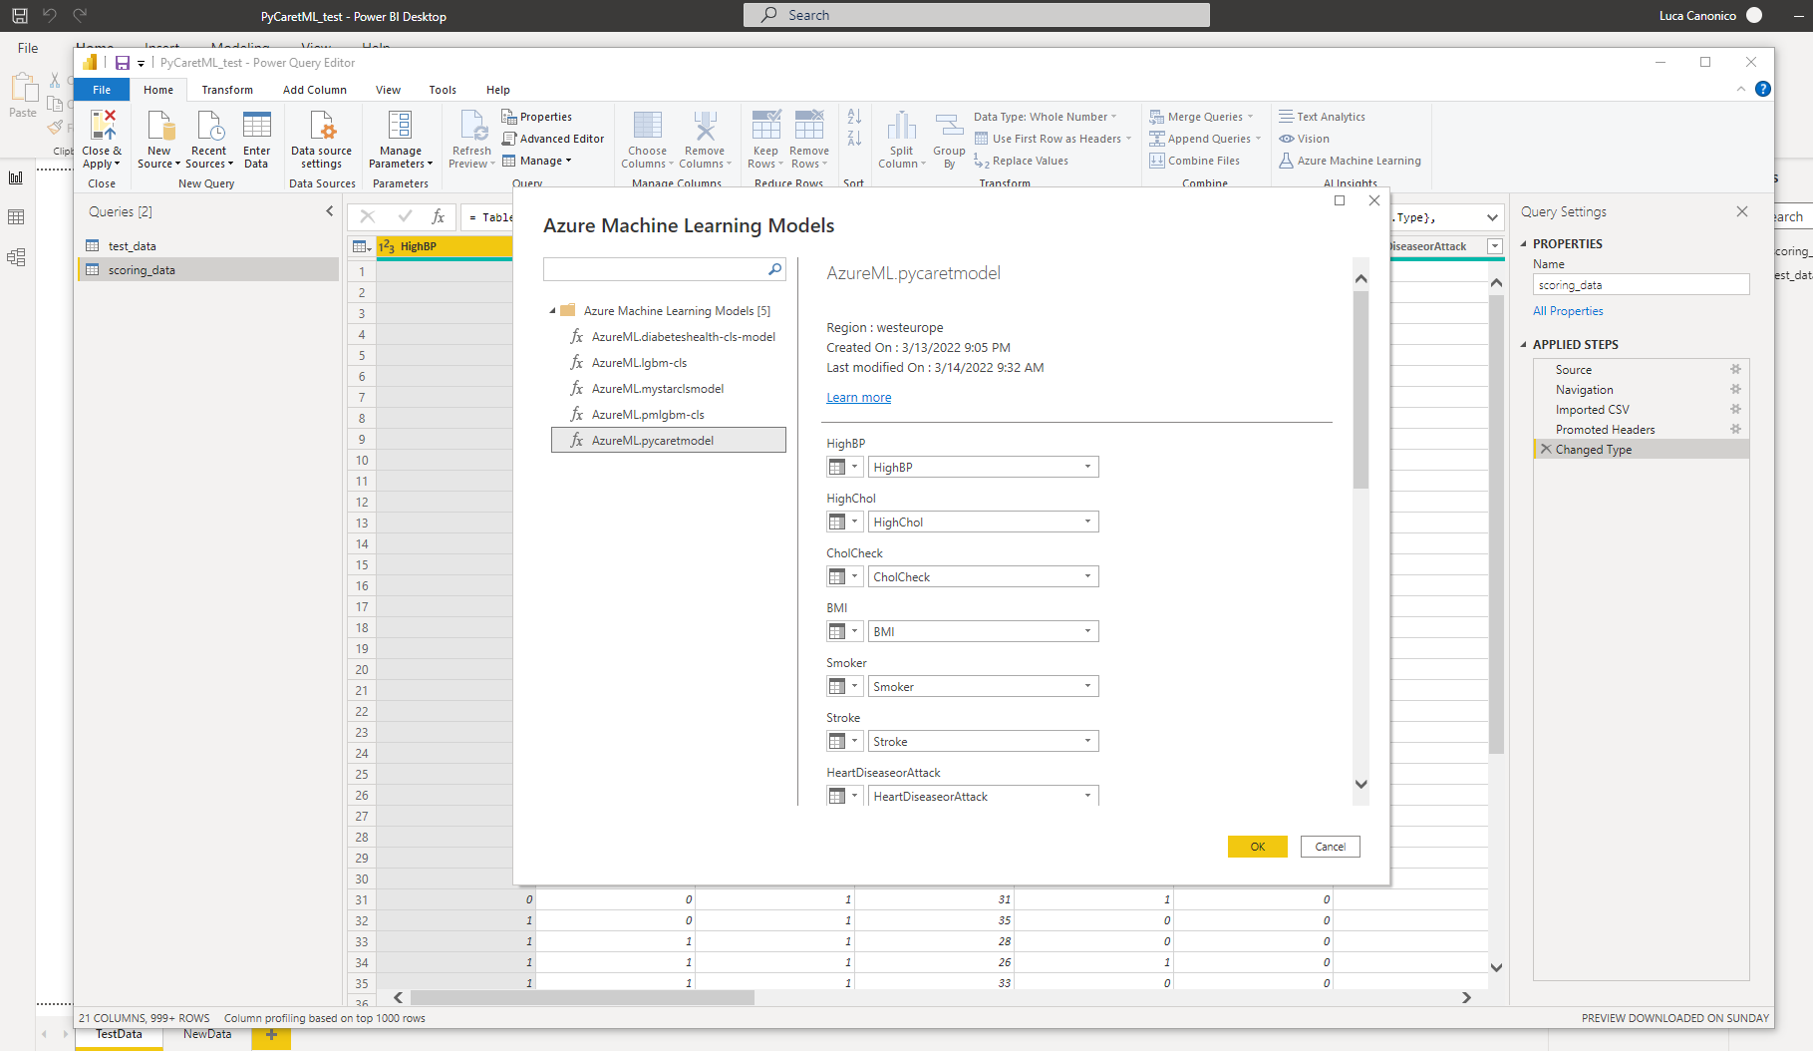
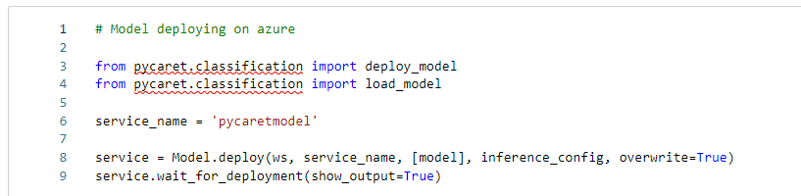

Slide 5
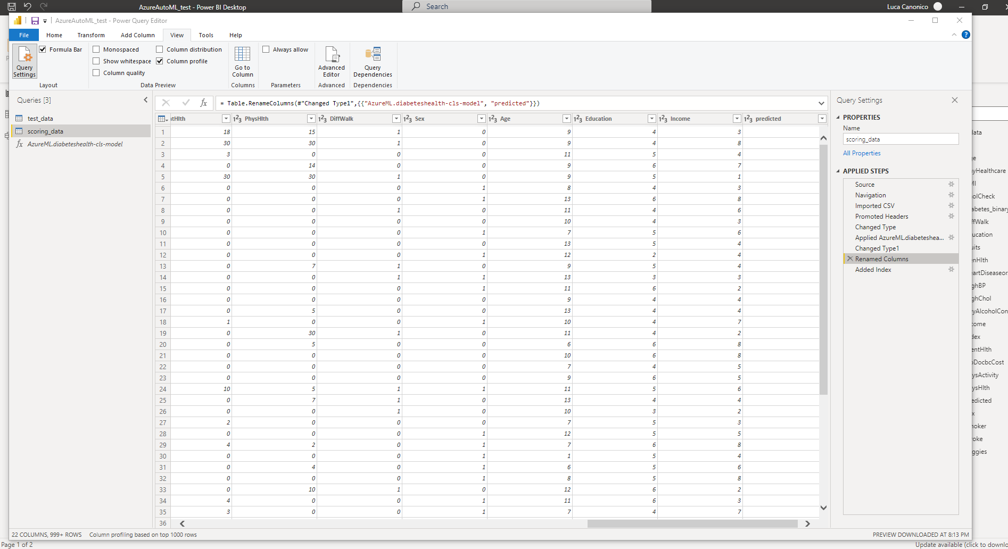
Check data type and rename column as predicted; apply the machine learning model also on the test_data and do the same operation; then close&apply PowerQueryEditor!

Slide 6
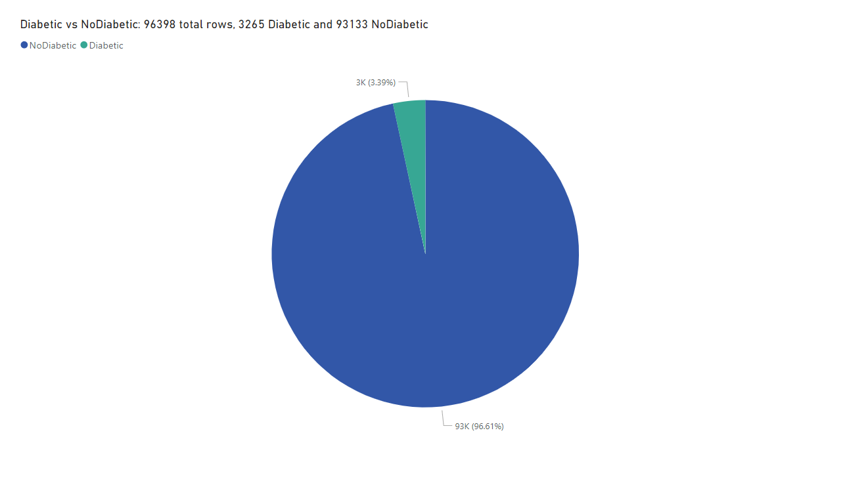
Pie Chart on new data

