Slide 1
Automated Machine Learning with Power BI dataflows
Automated machine learning (AutoML) for dataflows enables business analysts to train, validate, and invoke Machine Learning (ML) models directly in Power BI. It includes a simple experience for creating a new ML model where analysts can use their dataflows to specify the input data for training the model. The service automatically extracts the most relevant features, selects an appropriate algorithm, and tunes and validates the ML model. After a model is trained, Power BI automatically generates a performance report that includes the results of the validation. The model can then be invoked on any new or updated data within the dataflow.
See Automated Machine Learning in Power BI Microsoft documentation.
Prerequisites
Power BI premium-per-user licenze or premium-per-capacity
Get started
Sing in to Power BI
Select your workspace

Slide 2
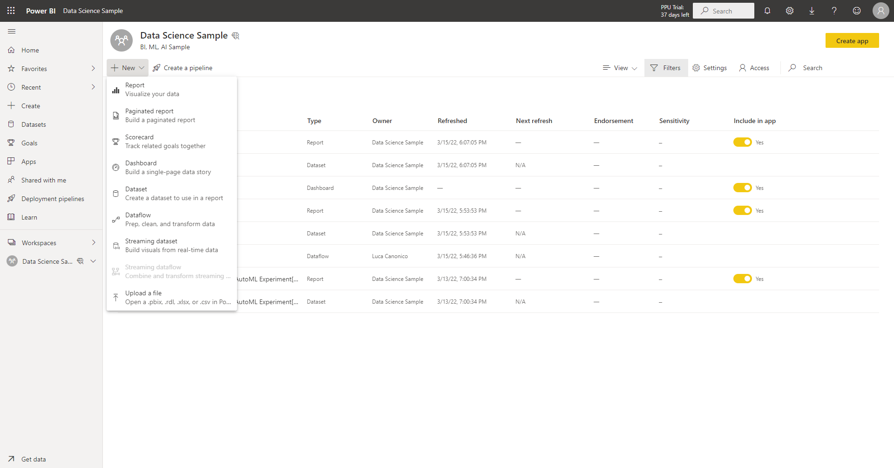

Slide 3
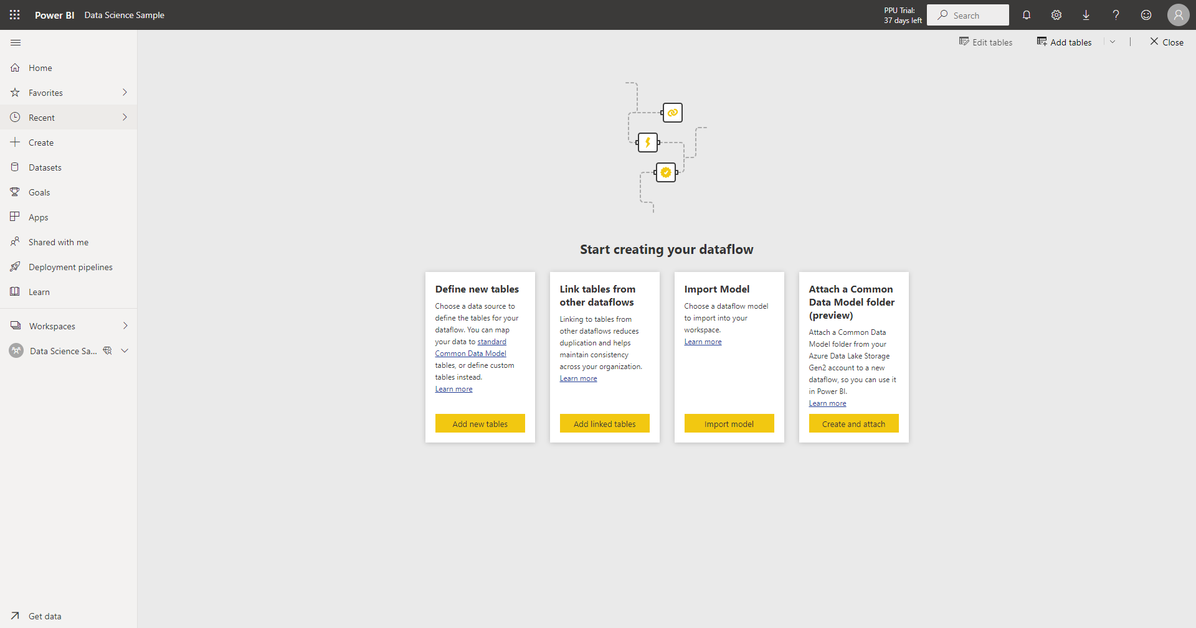

Slide 4
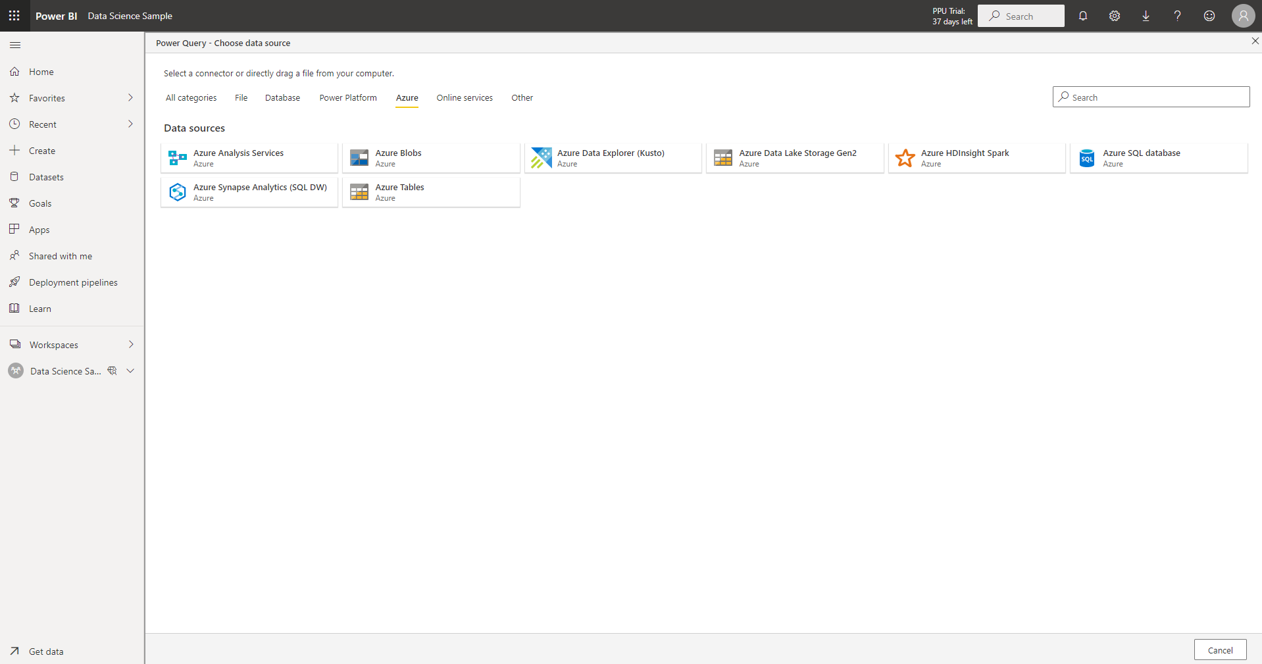

Slide 5
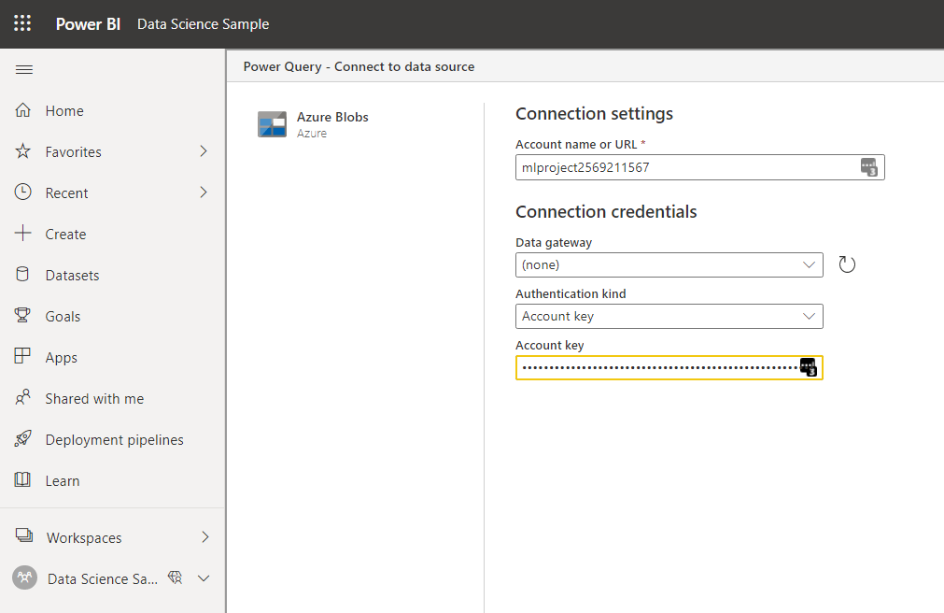
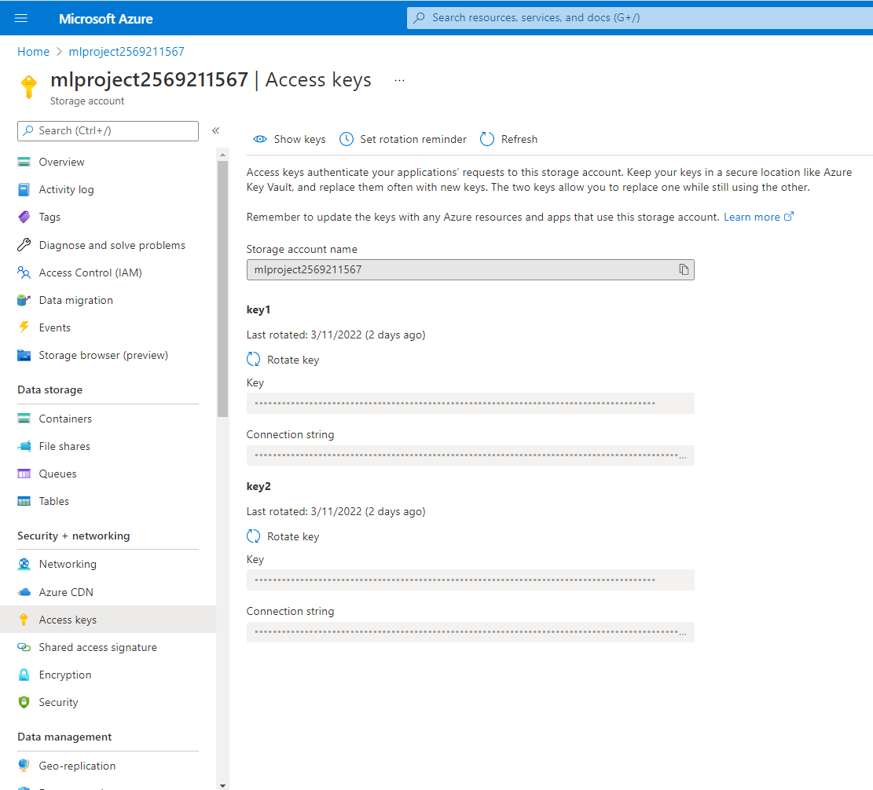
Go to your storage account > access keys and retrieve Storage account name and Key

Slide 6
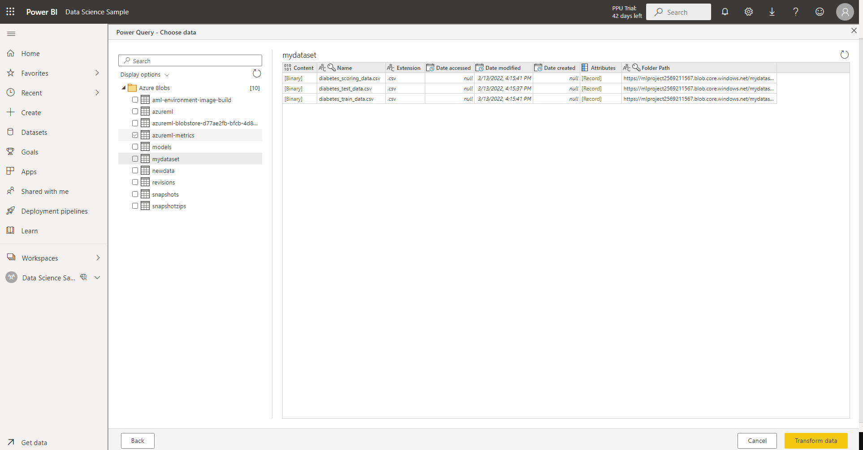
You can create a container in your storage account with dataset.
Click Transform data

Slide 7
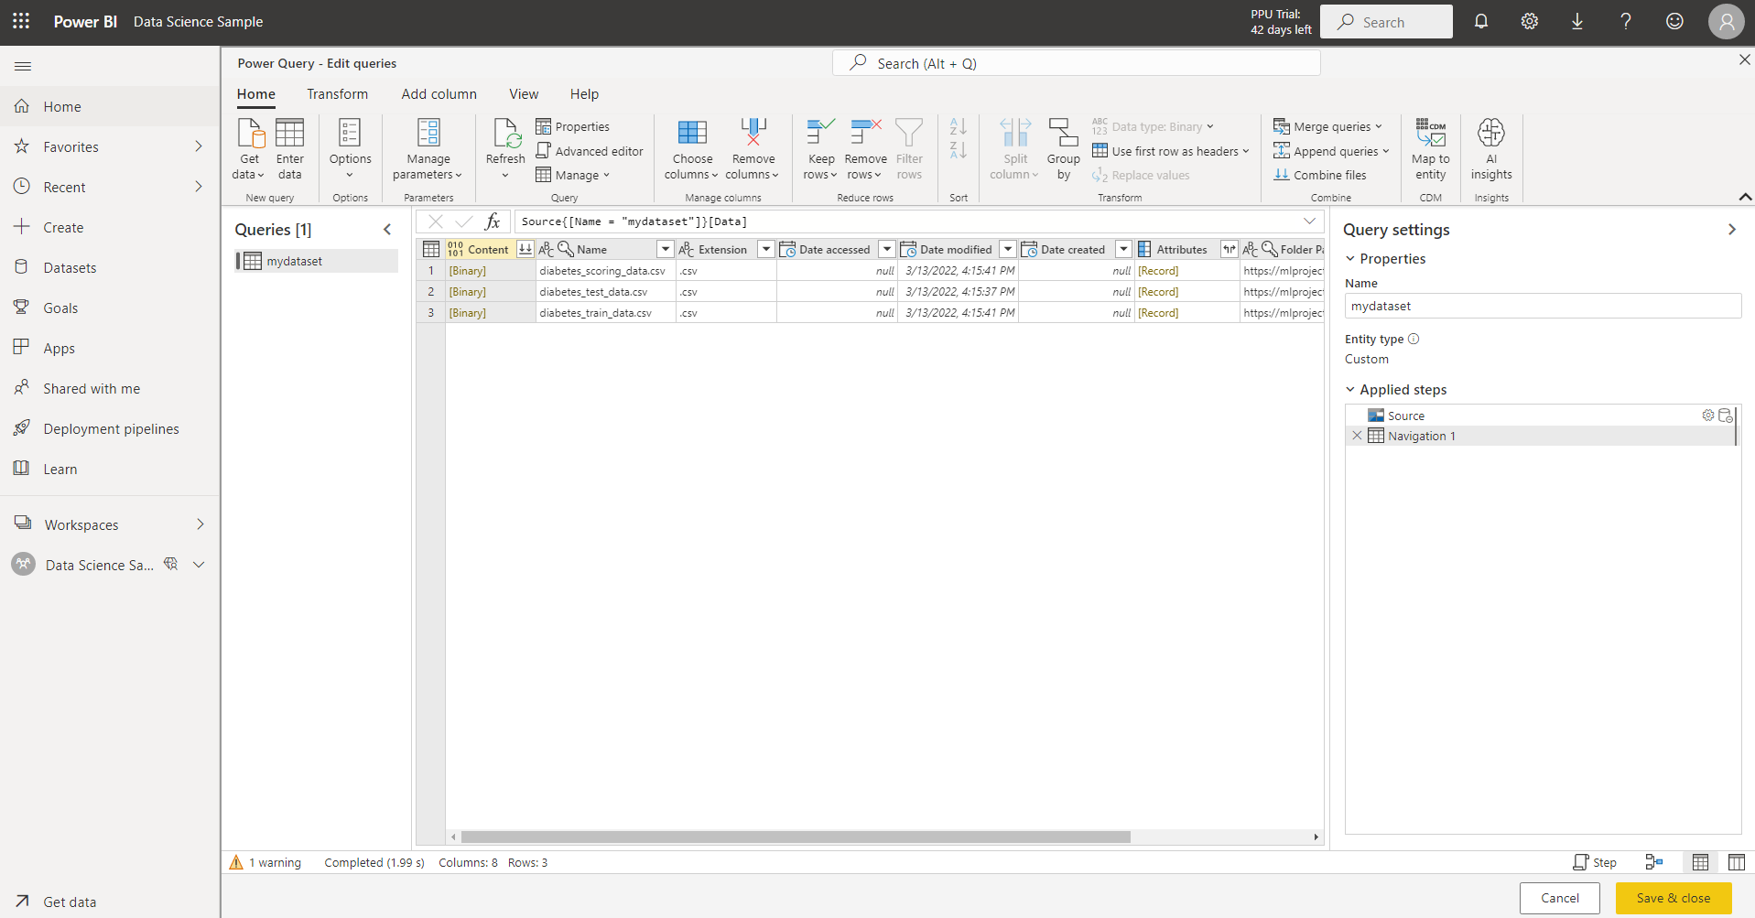
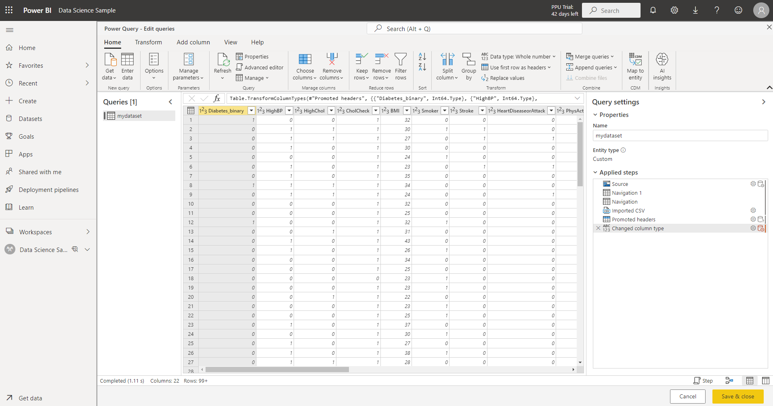
Change dataset name in train_set

Slide 8
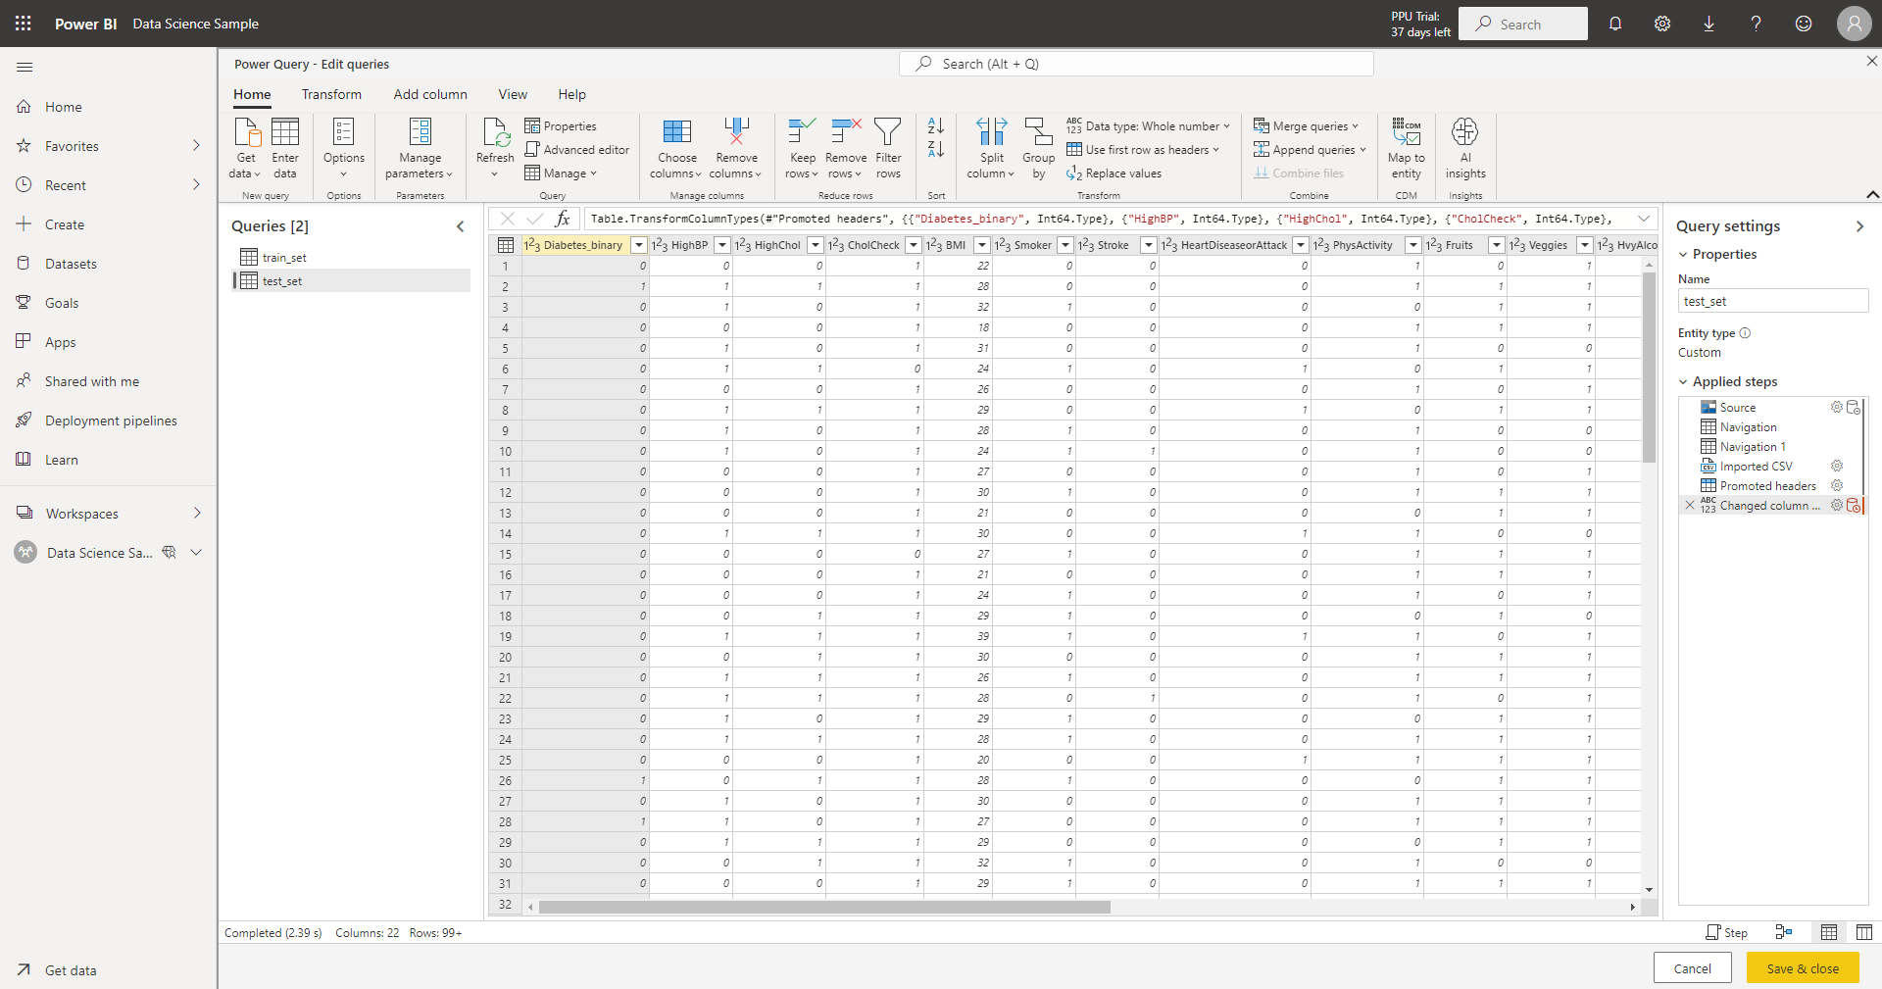
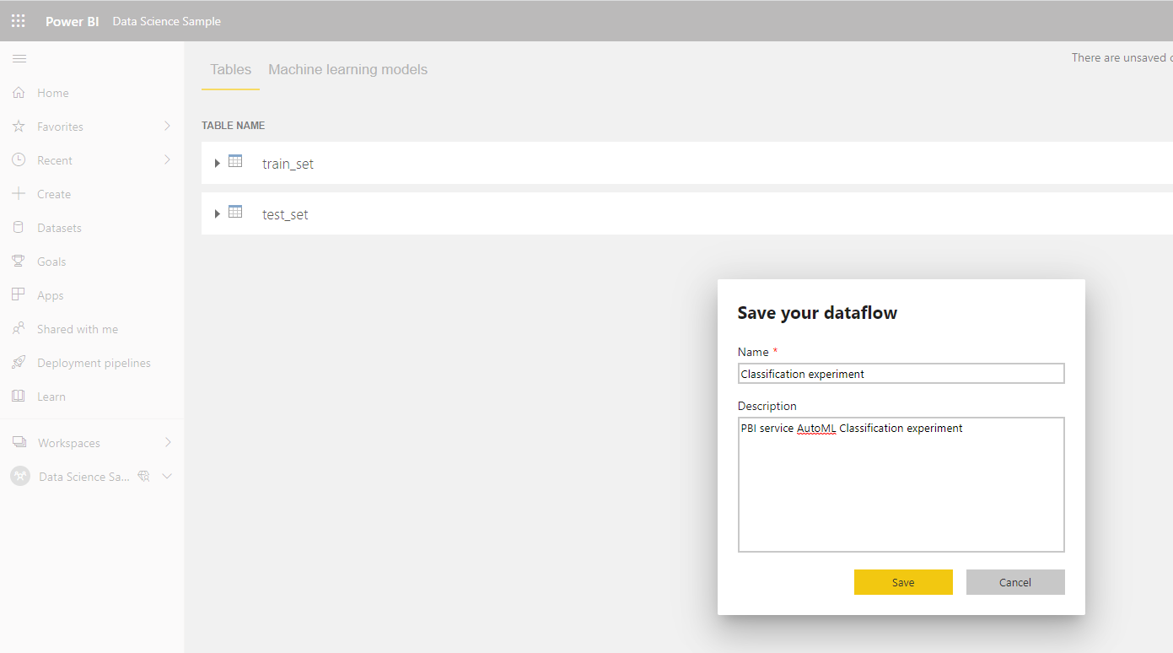
Provide your test dataset to evaluate the model that automated ML generates for you at the end of the training experiment.
Click save and close.
Then, save your dataflow

Slide 9
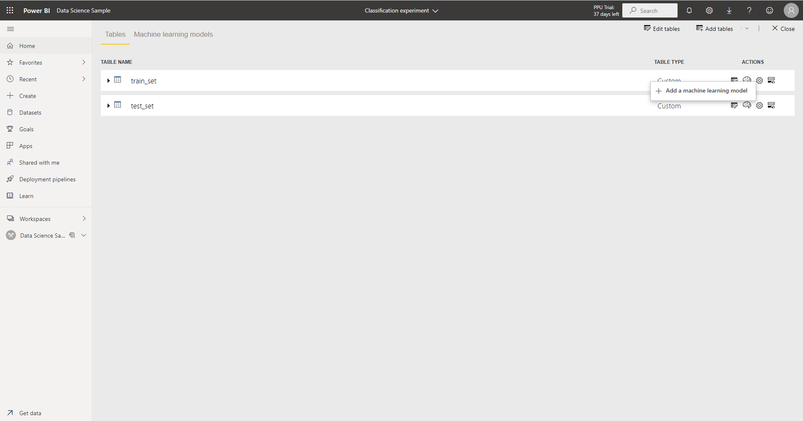

Slide 10
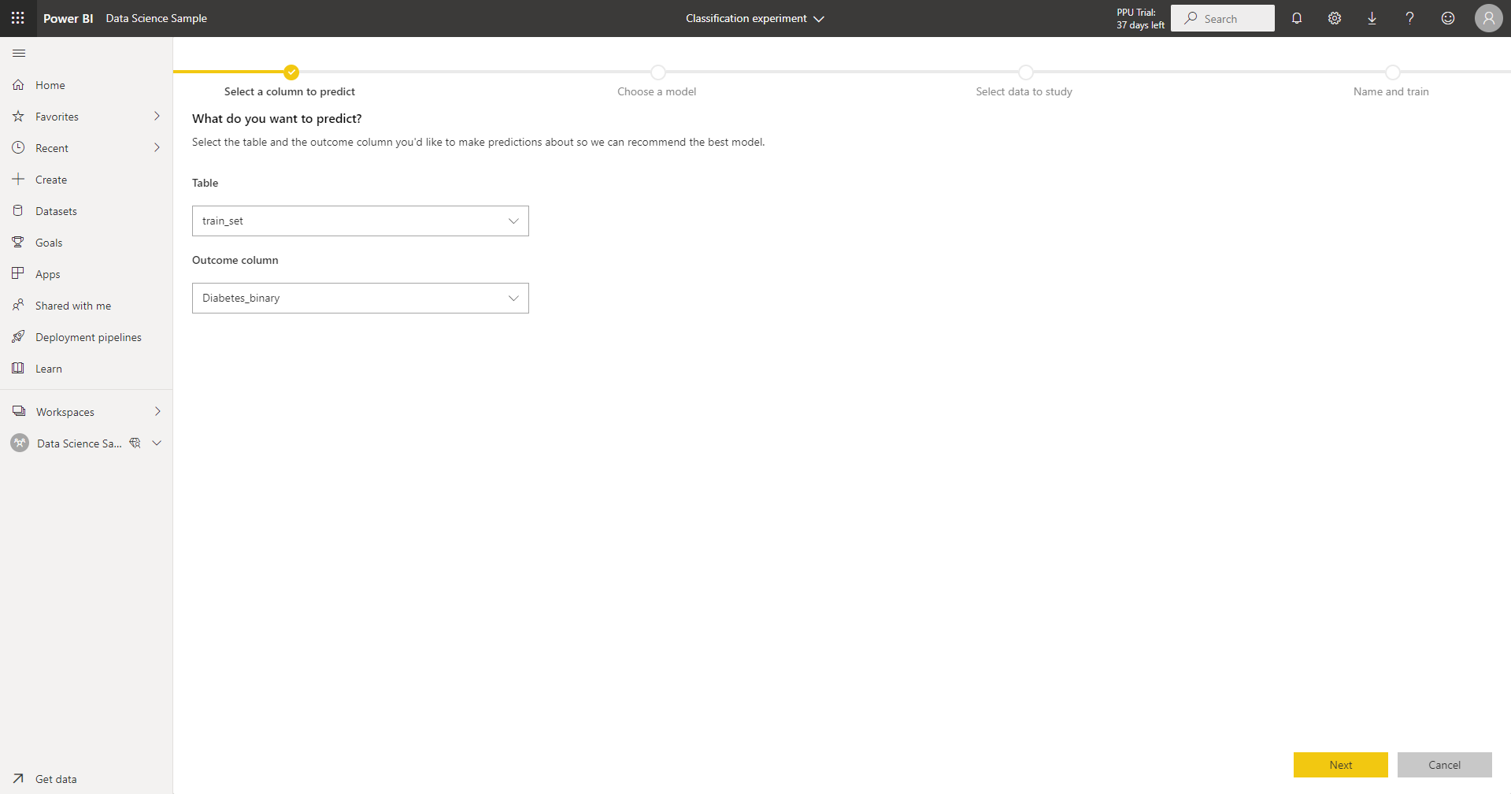

Slide 11
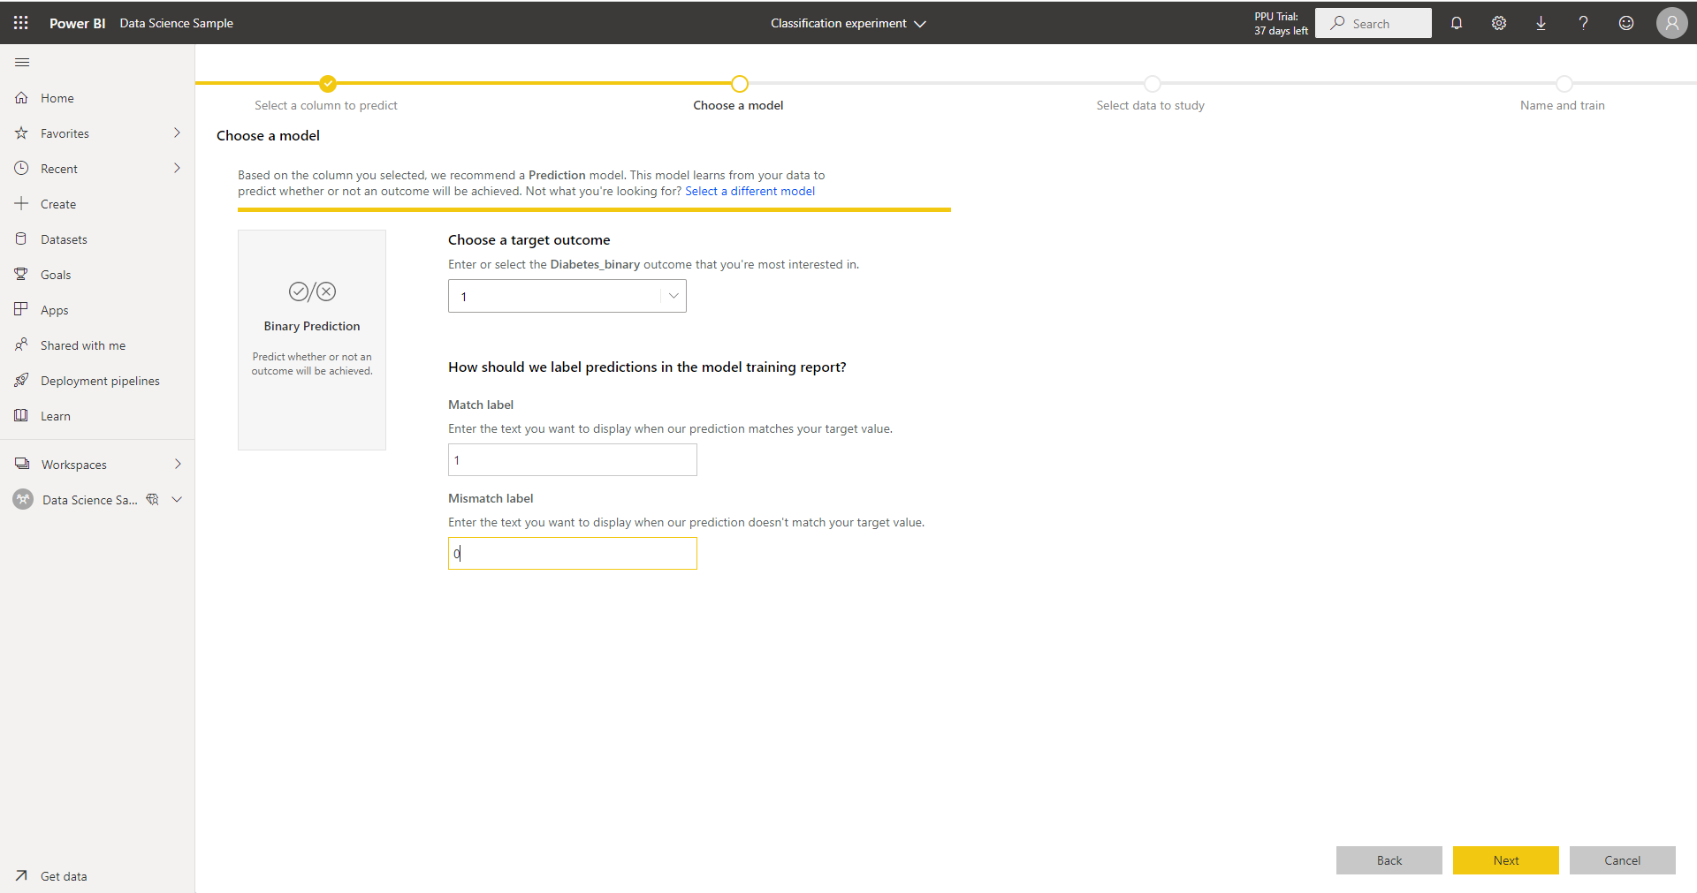
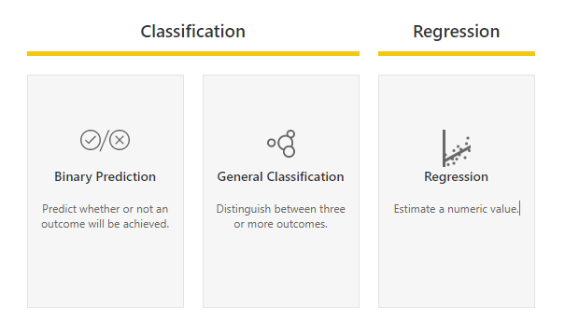
Based on the column you selected, we recommend a Prediction model. This model learns from your data to predict whether or not an outcome will be achieved. Not what you're looking for? Select a different model

Slide 12
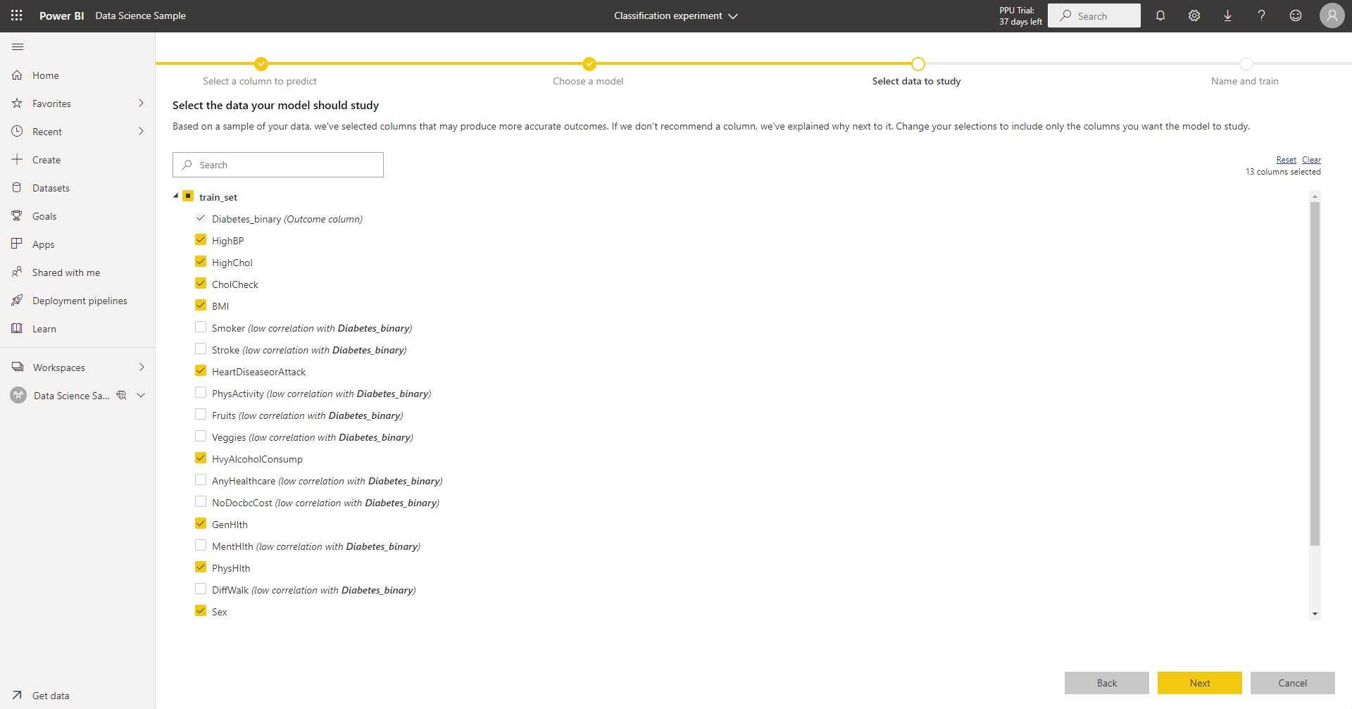
I get recommended suggestions

Slide 13
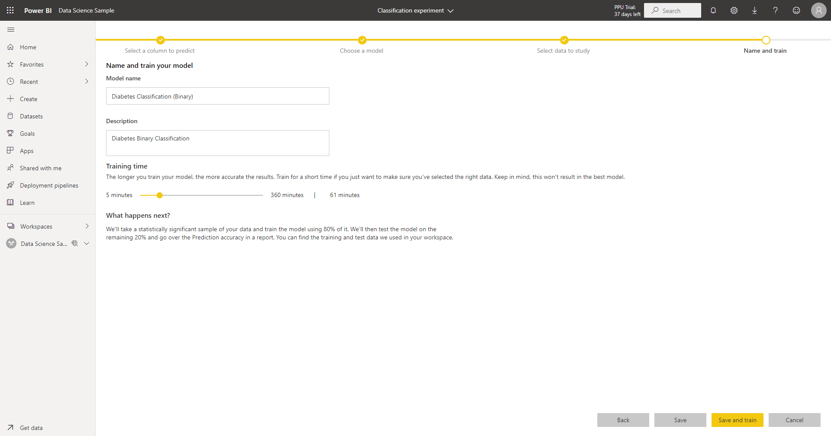
60 minutes training time

Slide 14
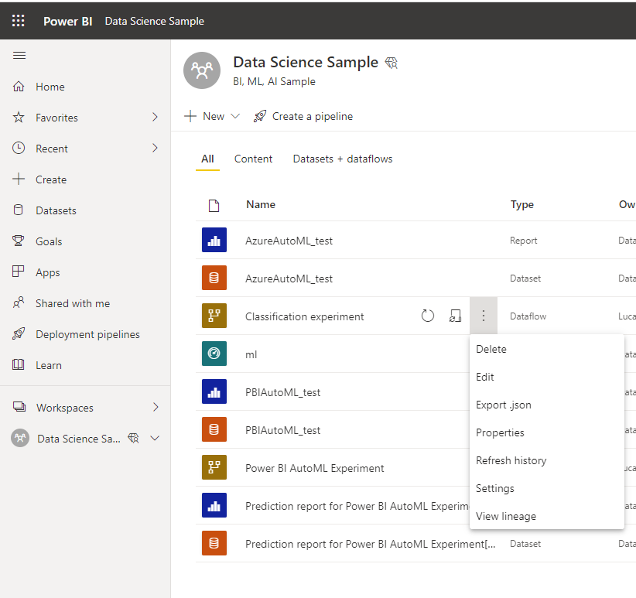
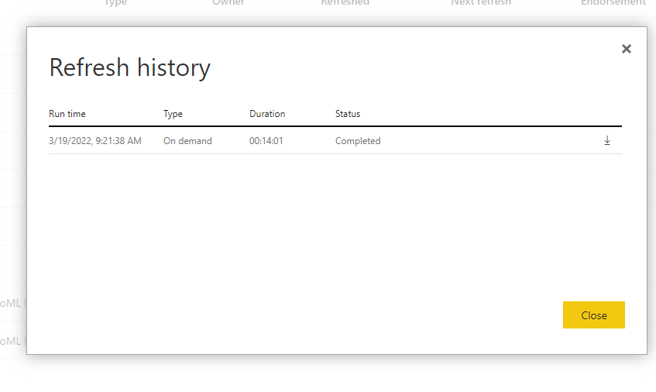
14m to complete model training

Slide 15
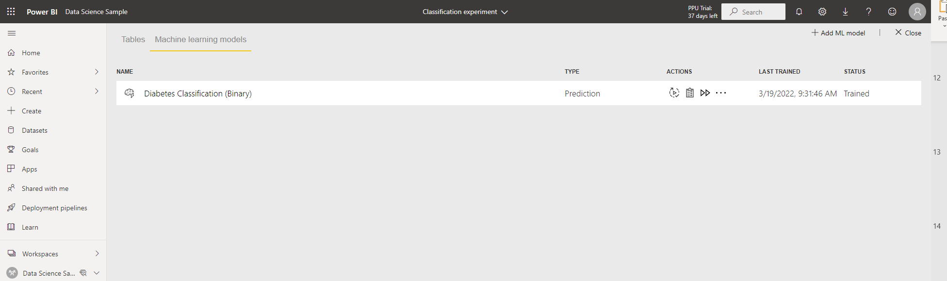
View training report:
Model Performance
Accuracy Report
Training Details

Slide 16
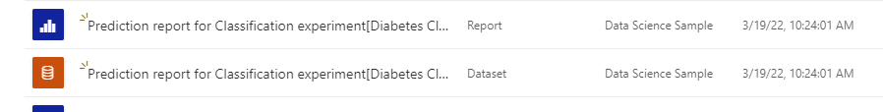
You can find dataset and prediction report in your workspace.
If the performance of the model is satisfactory you can apply the model on new unlabeled data and import them in a Power BI report!
Explore Prediction report above in this article!

Slide 17
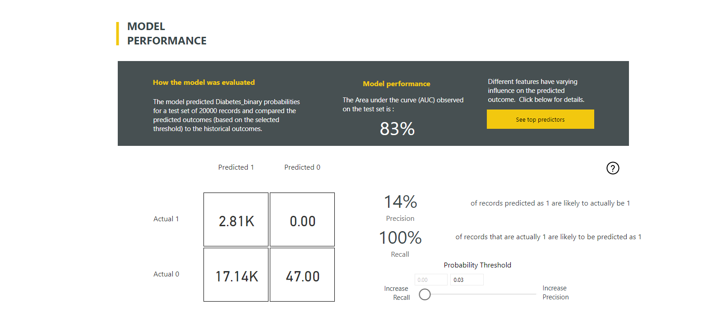
These is only one screenshot, explore all report info!
Explore embed report in my article!!

Slide 18
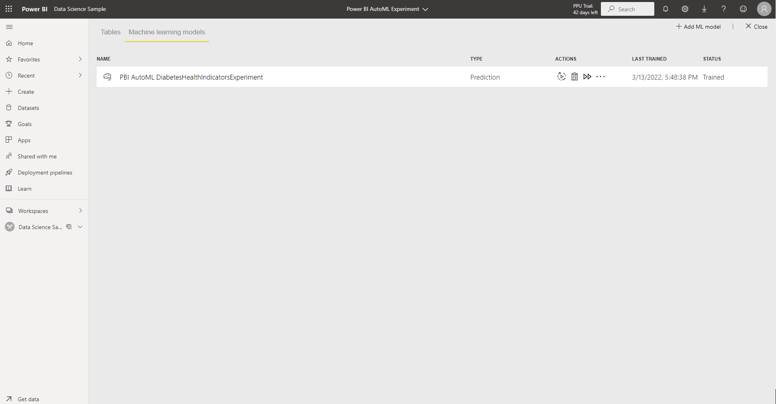
You can now apply trained model on new data.
Add test_set on dataflow and apply model!

Slide 19
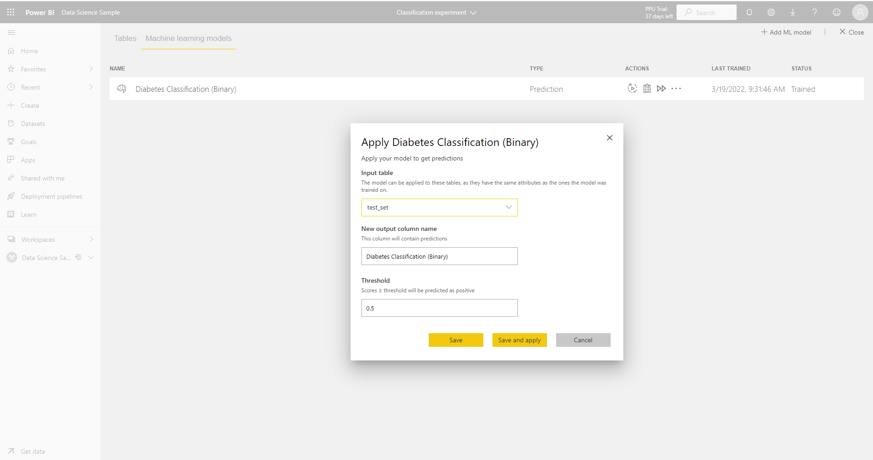
You can apply trained model on test data (labeled) before applying it on new unlabeled data (scoring data).
(remember that you can find datasets at the beginning of my article)

Slide 20
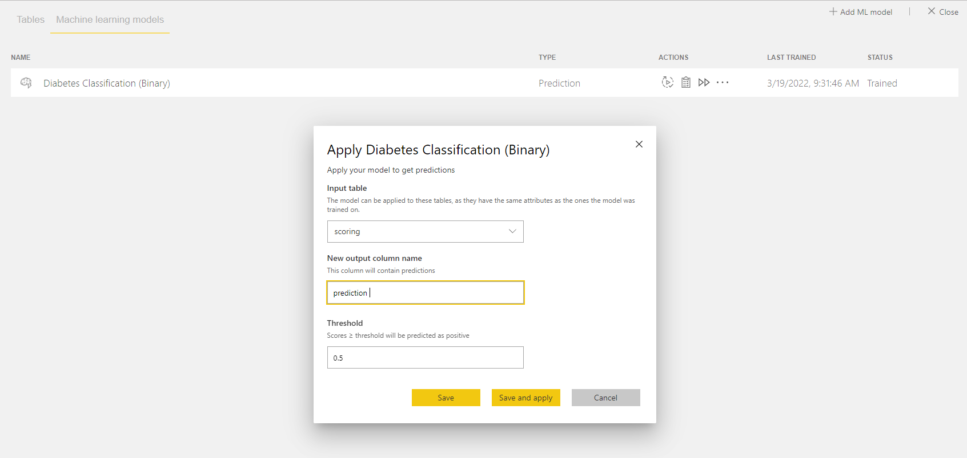
Make prediction on new data
Applying trained model on new data to make prediction (I’ve imported scoring dataset on workflow)

Slide 21
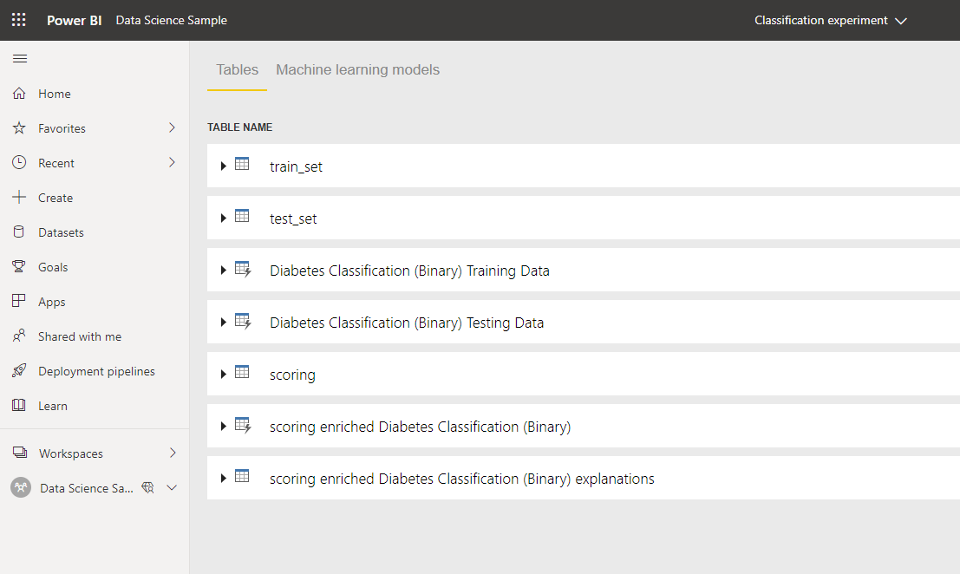
Make prediction on new data
Applying trained model on new data to make prediction (I’ve imported scoring dataset on workflow)

Slide 22
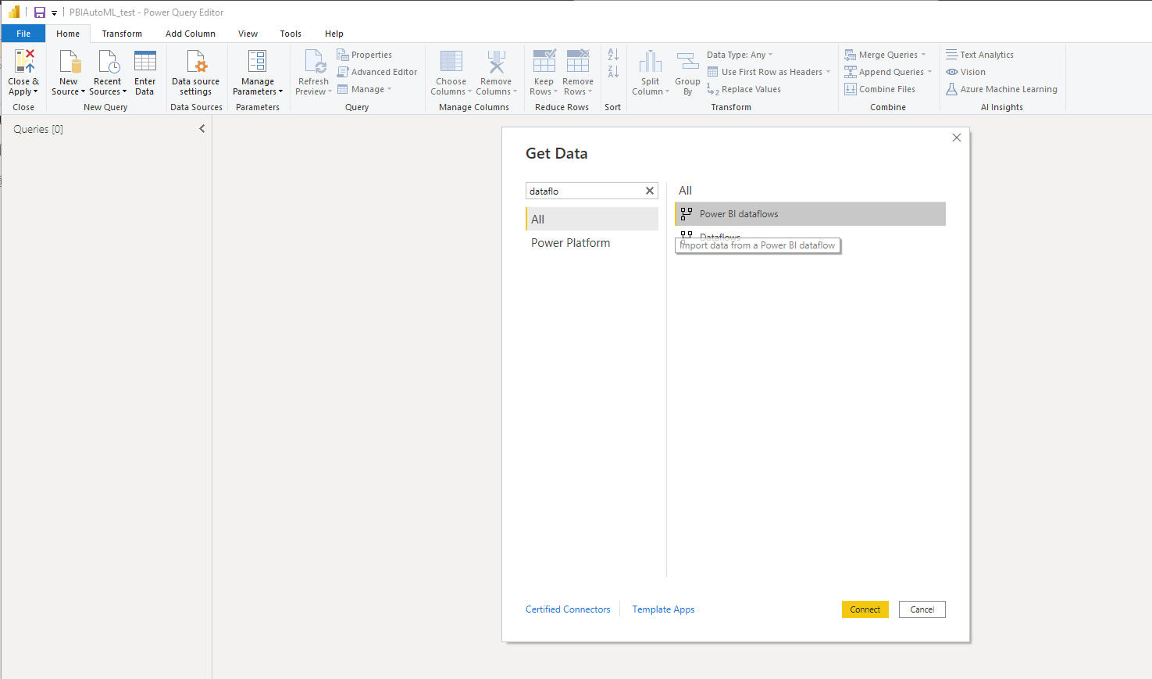
How to use in Power BI desktop?
Create new pbix file and get data from your dataflow.
You can import table on which ml model makes prediction

Slide 23
How to use in Power BI desktop?
Create new pbix file and get data from your dataflow.
You can import table on which ml model makes prediction

Slide 24
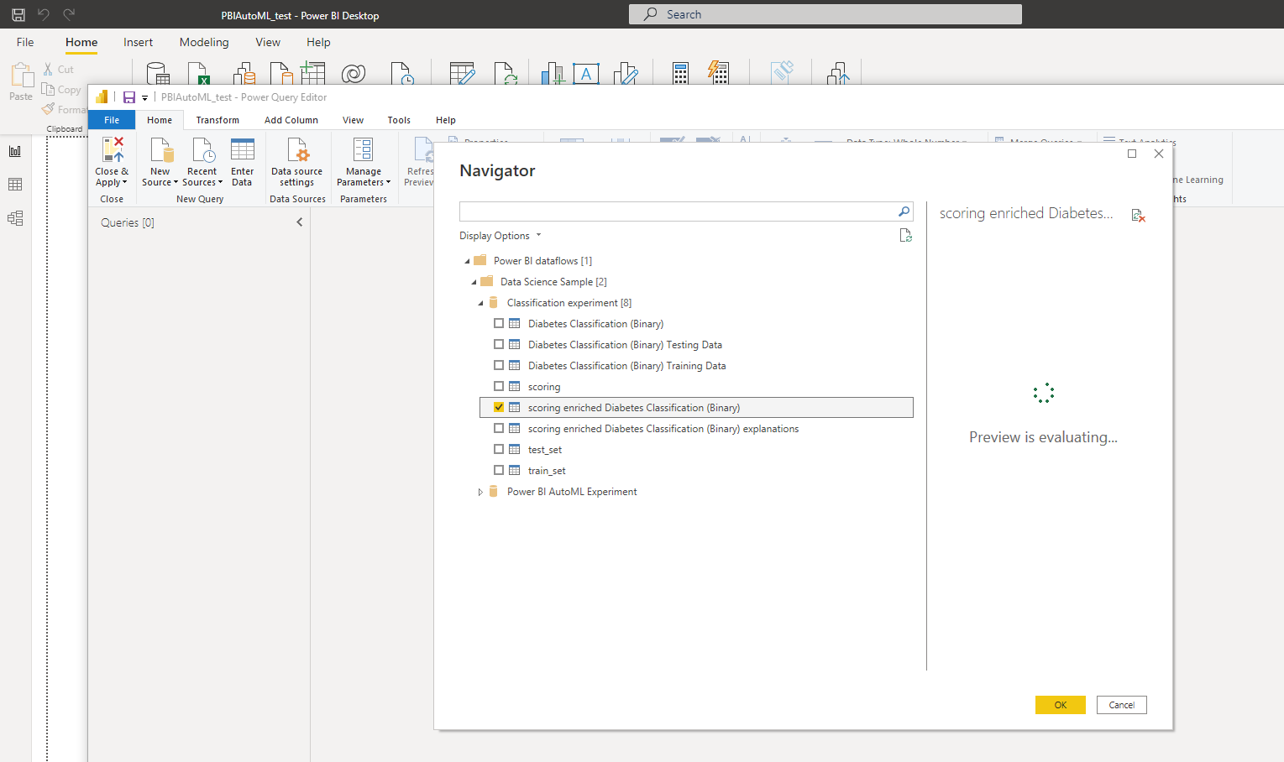

Slide 25
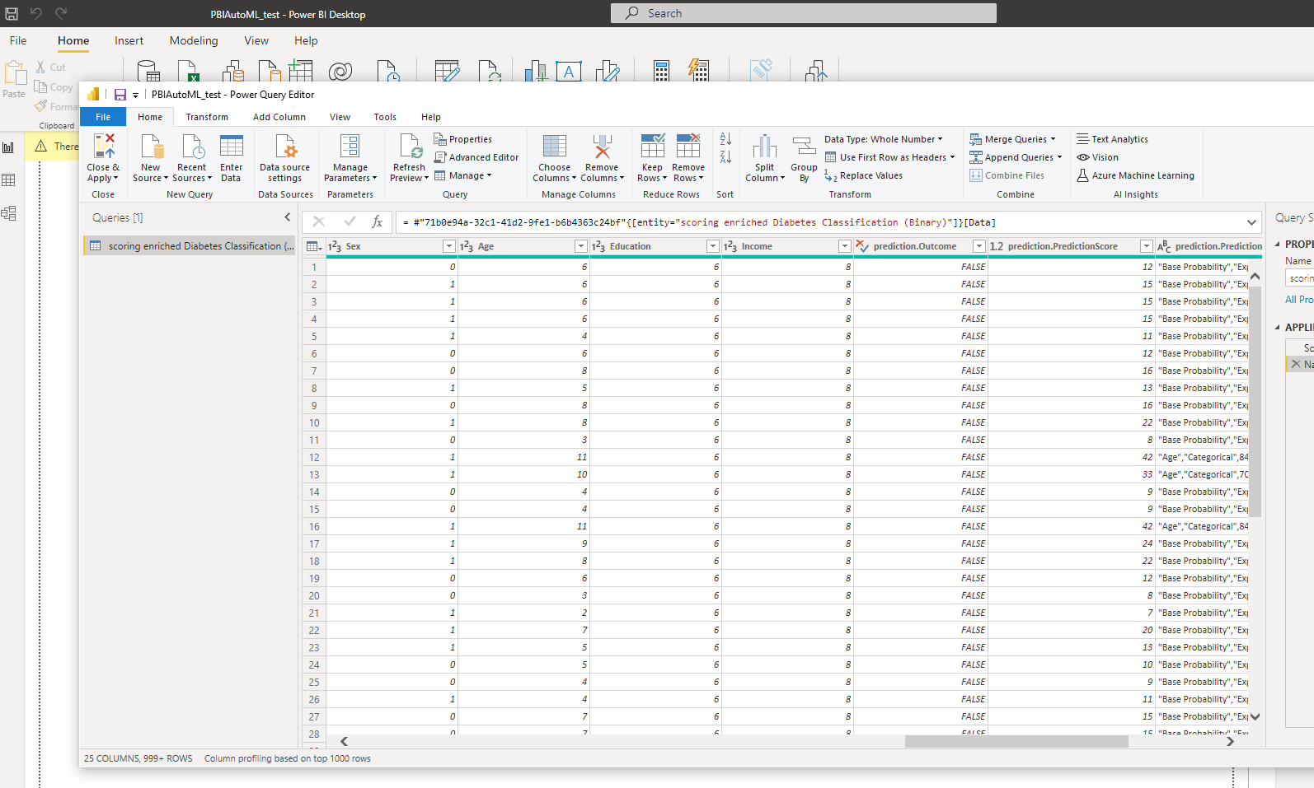
This is prediction column!
Rename it as prediction and change data type as whole number

Slide 26
