Slide 1
What is Azure Machine Learning studio?
Azure Machine Learning studio is the web portal for data scientist developers in Azure Machine Learning.
The studio combines no-code and code-first experiences for an inclusive data science platform.
See the Microsoft Automated ML overview
Prerequisites
An Azure subscription
An azure Machine Learning workspace
Get started
Sing in to Azure Machine Learning studio
Select your workspace

Slide 2
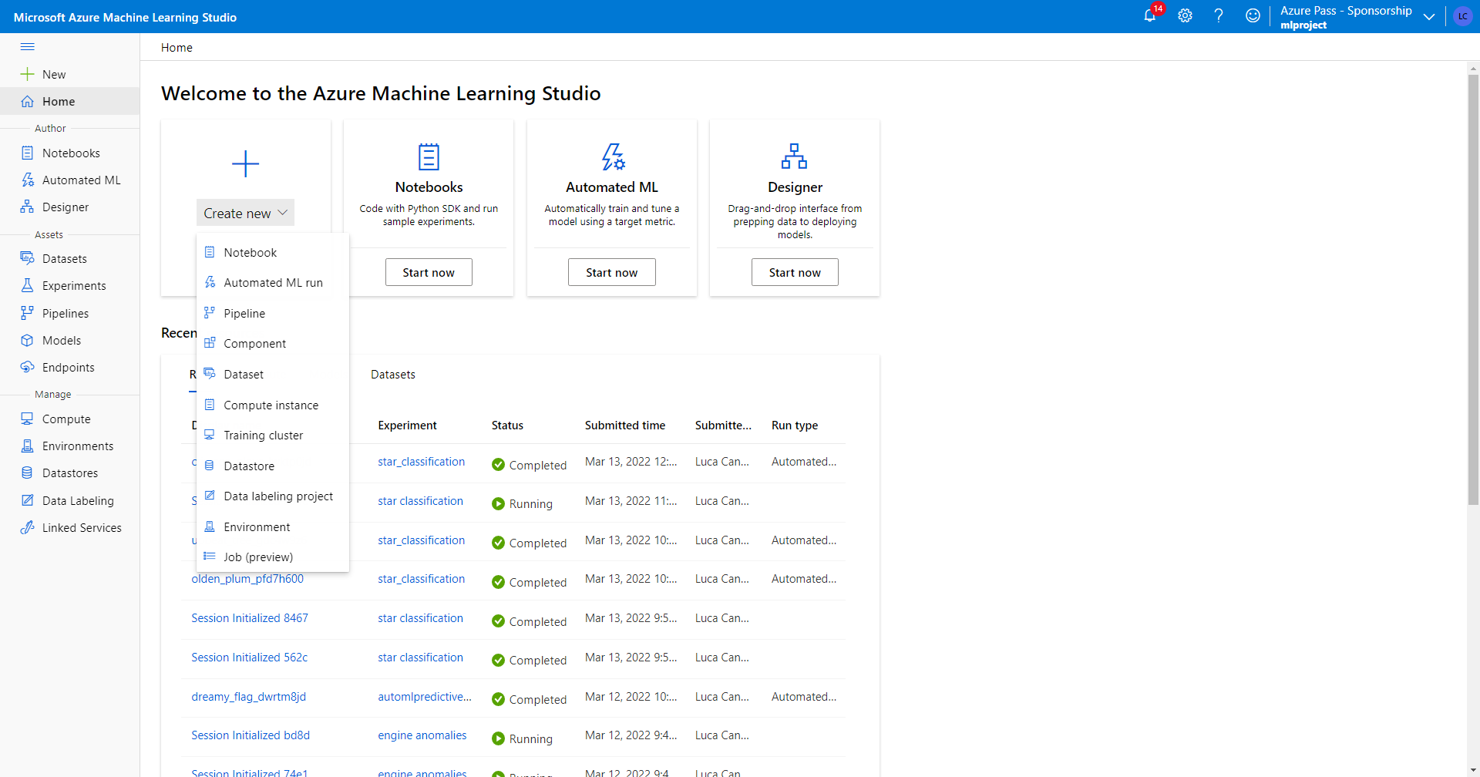

Slide 3
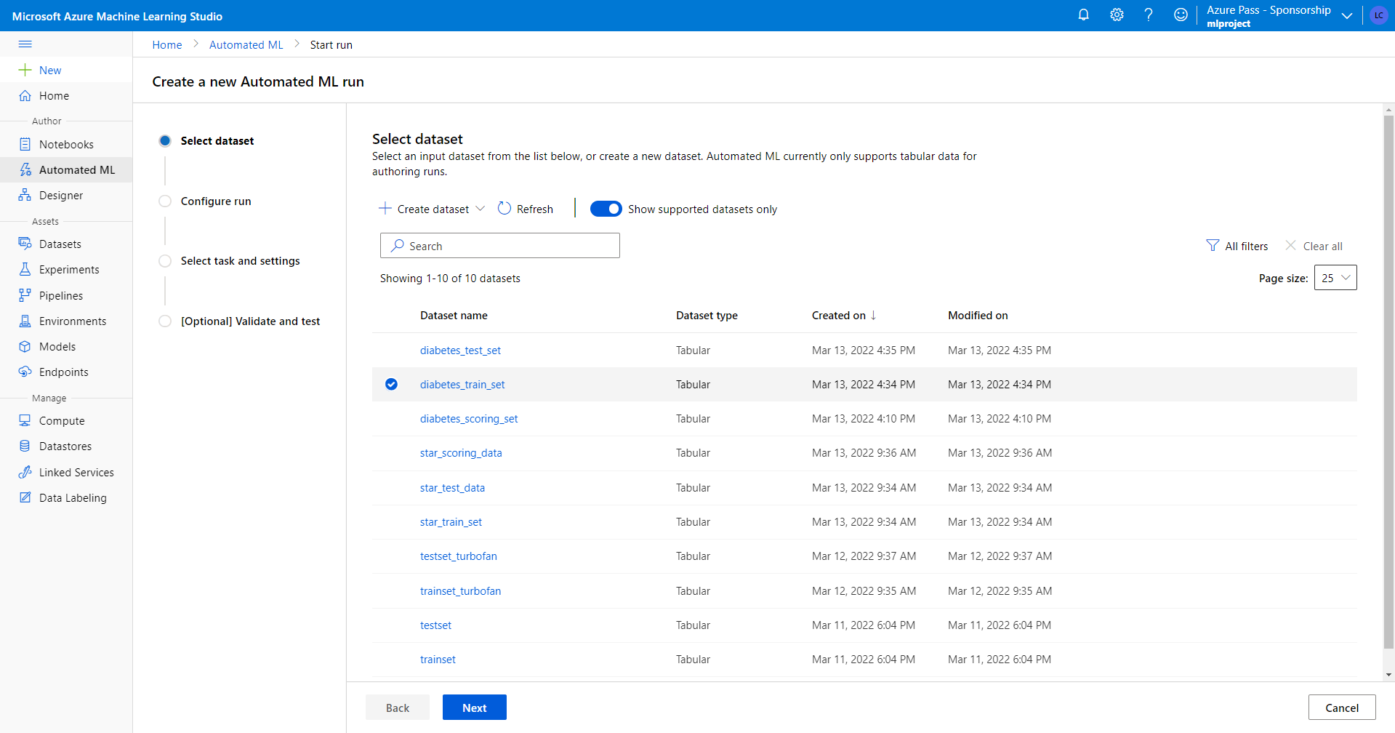

Slide 4
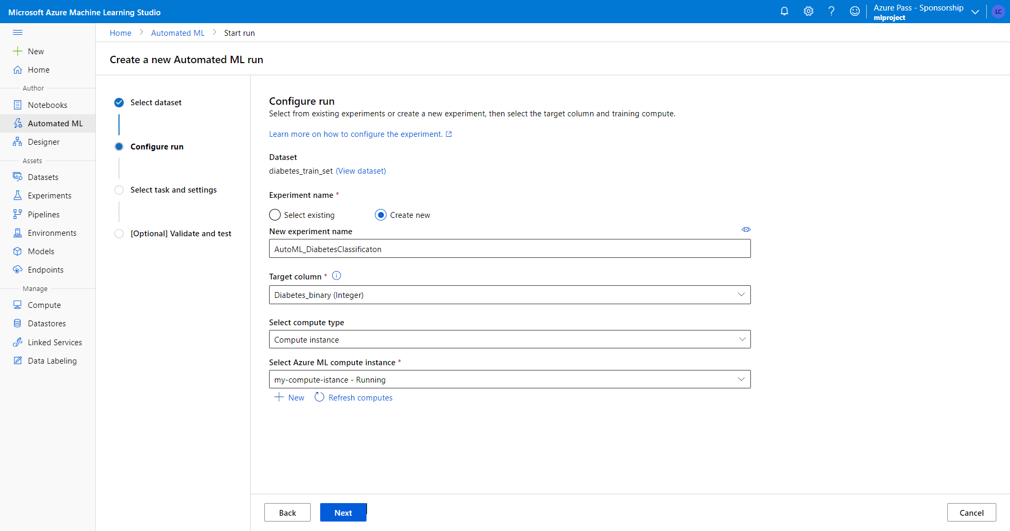
Click here if you want to read Microsoft documentation
In order to complete the configuration run, you have to:
Naming experiment
Indicate target column
Select compute istance

Slide 5
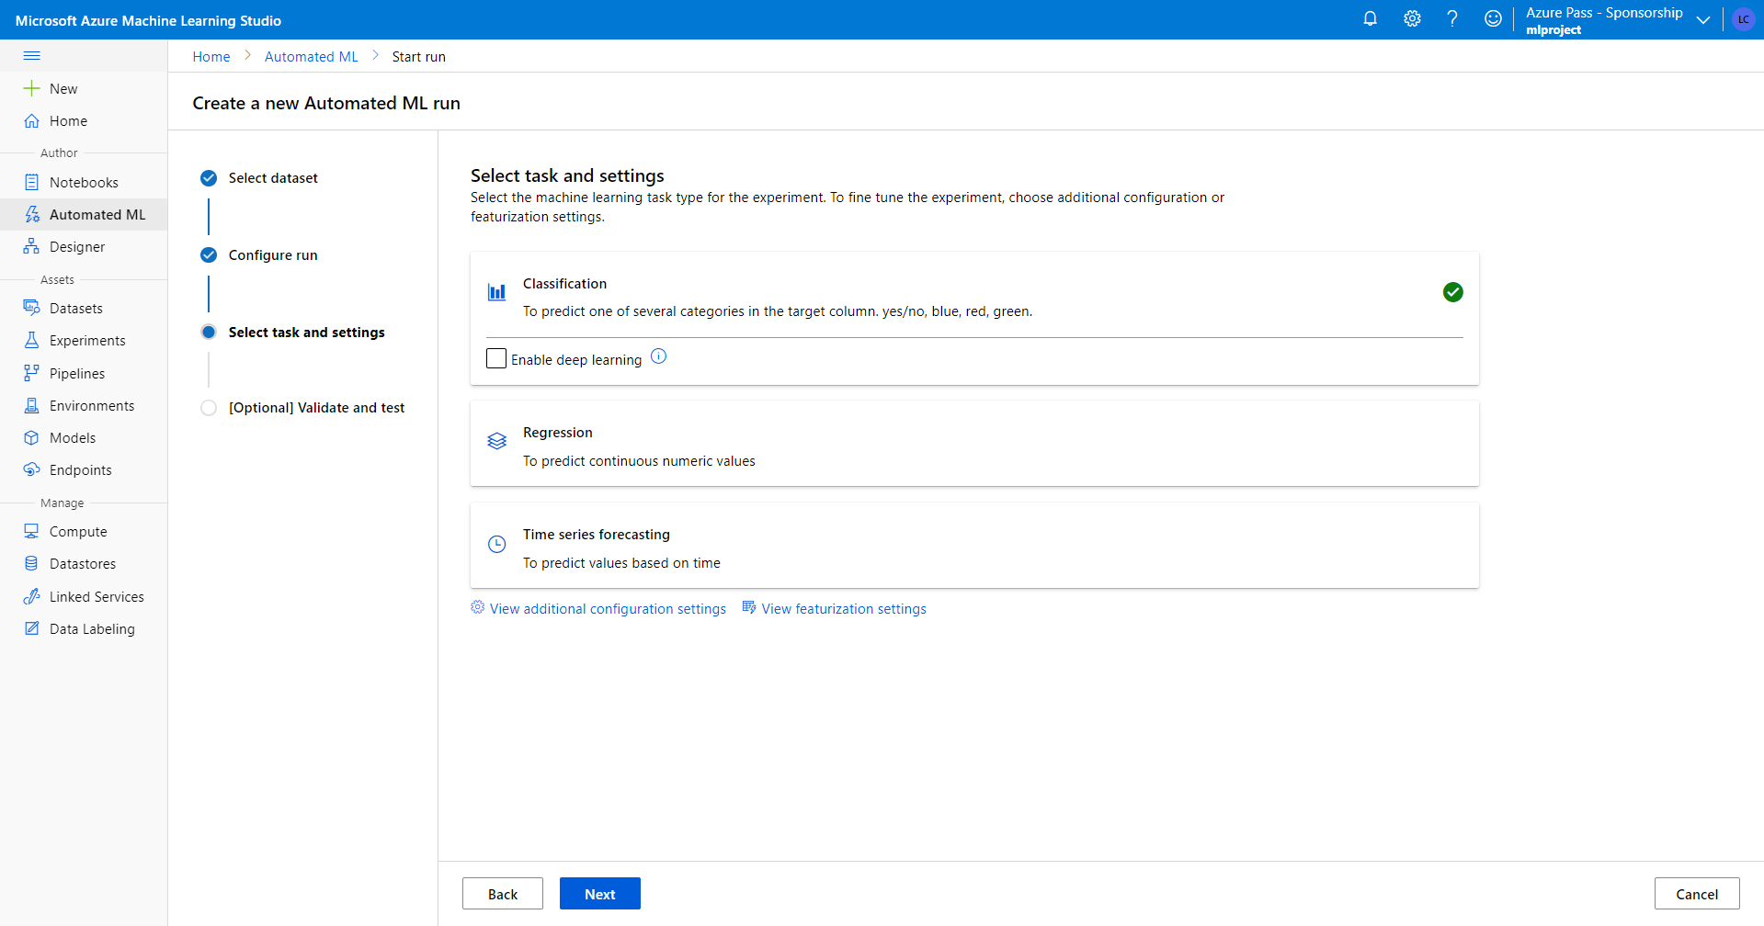

Slide 6
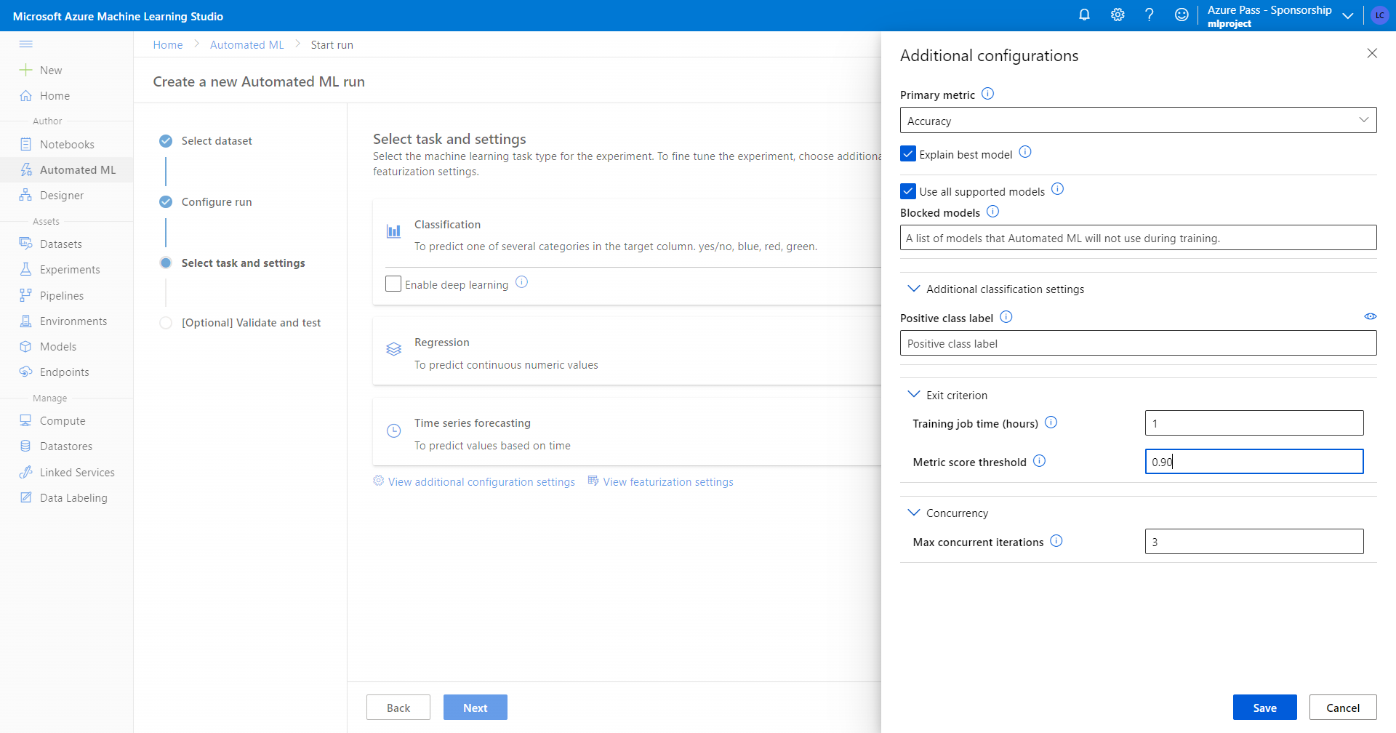
When any of these criteria are met, the training job is stopped.
Training job time (hours): How long to allow the training job to run.
Metric score threshold: Minimum metric score for all pipelines. This ensures that if you have a defined target metric you want to reach, you do not spend more time on the training job than necessary.

Slide 7
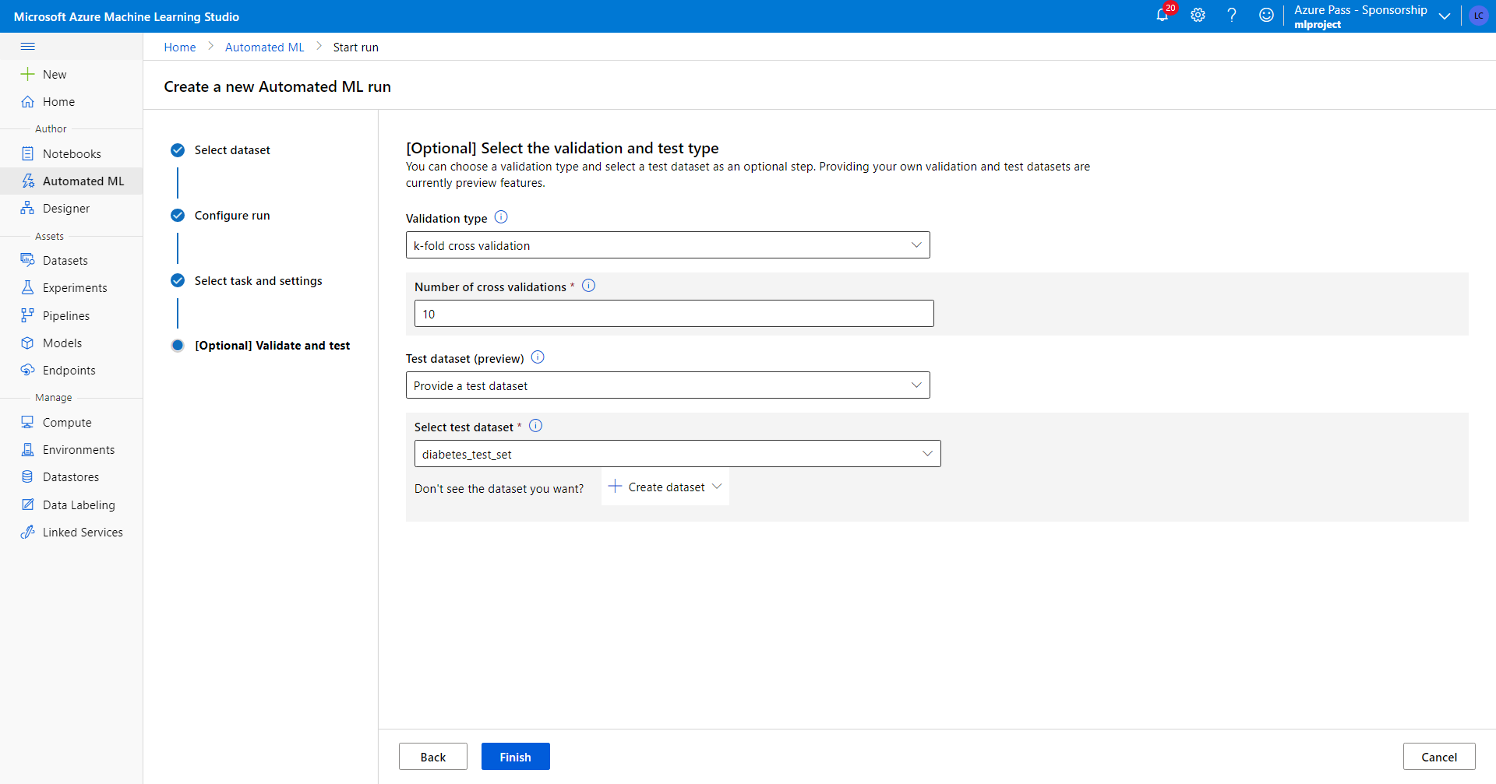
Provide a test dataset (preview) to evaluate the recommended model that automated ML generates for you at the end of your experiment. When you provide test data, a test run is automatically triggered at the end of your experiment. This test run is only run on the best model that was recommended by automated ML. Test data is considered a separate from training and validation, so as to not bias the results of the test run of the recommended model.

Slide 8
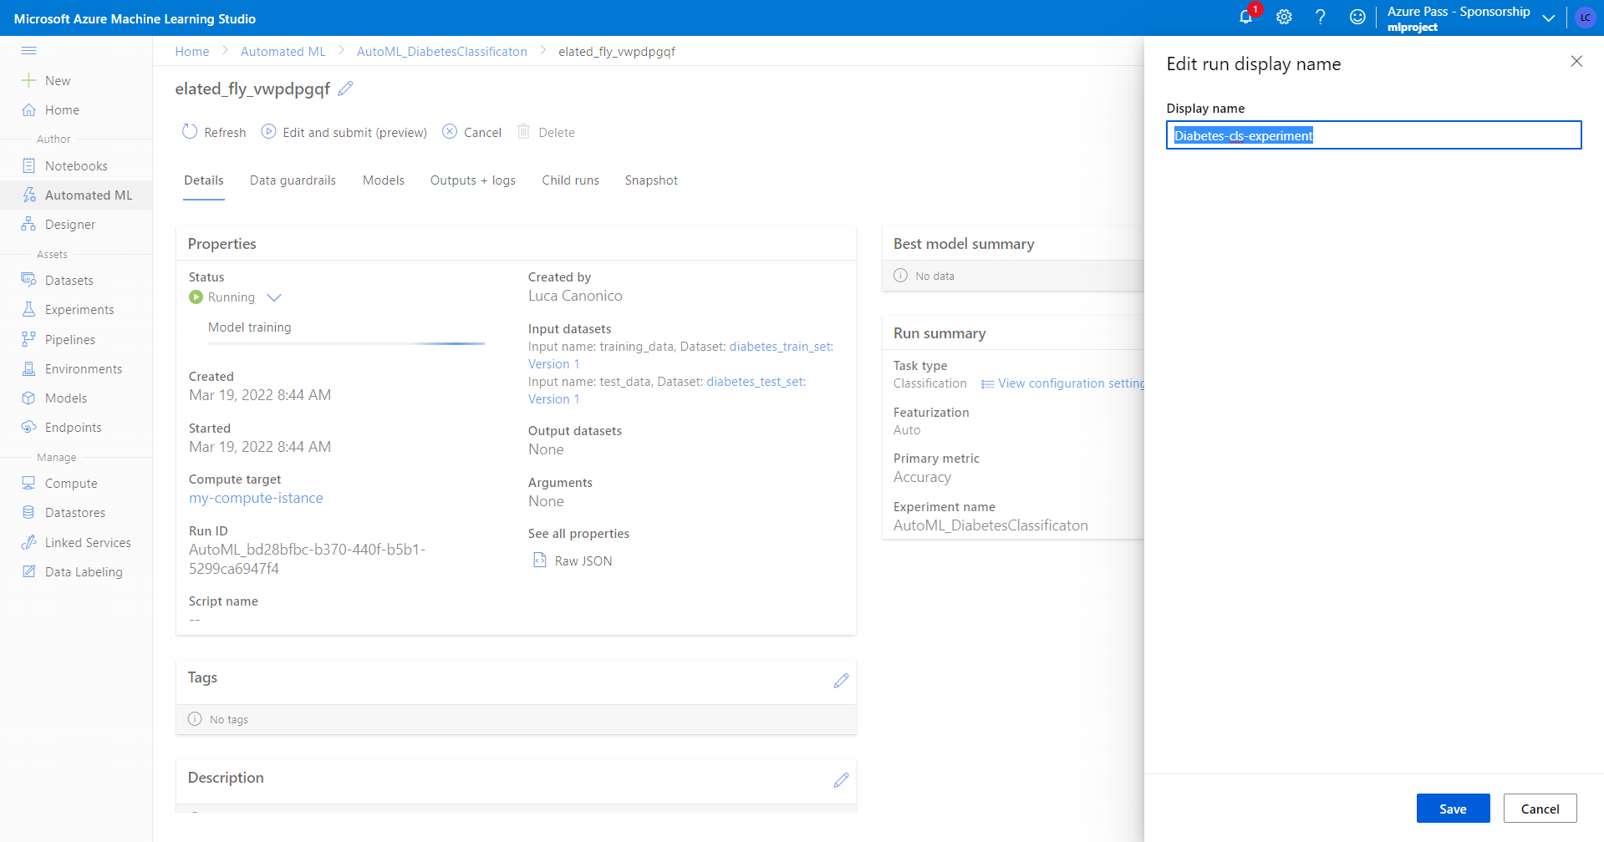

Slide 9
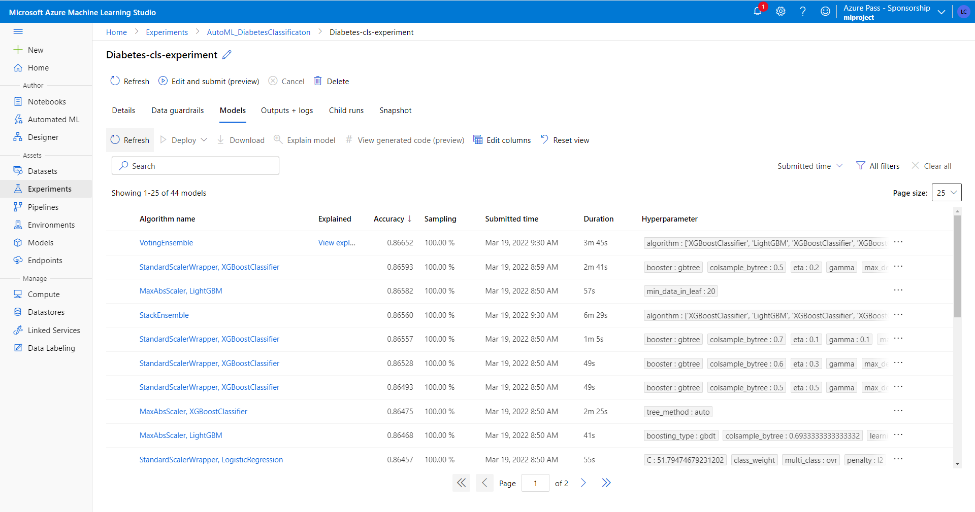
during training you can see all models compared

Slide 10
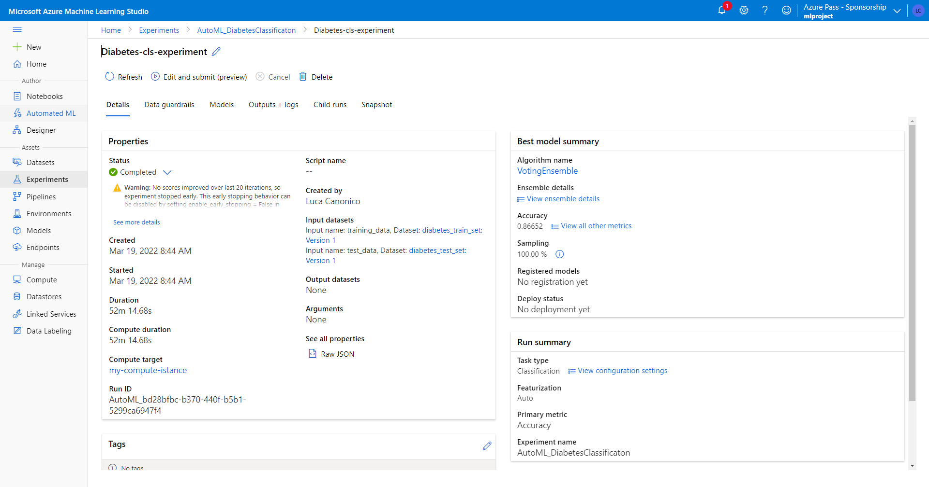
Explore all metrics for the best model

Slide 11
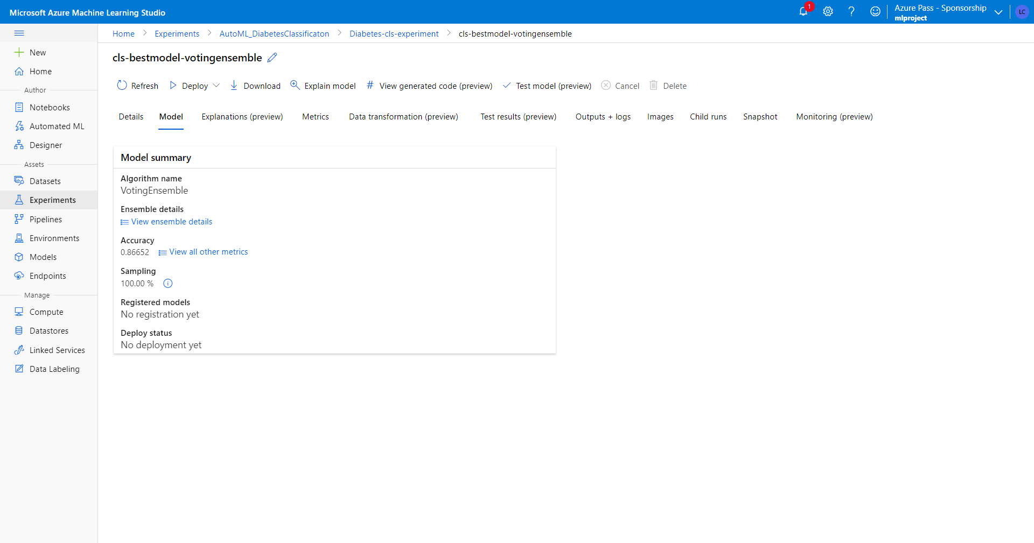
You can see the best model performance on test set
You can rename the best model running experiment

Slide 12
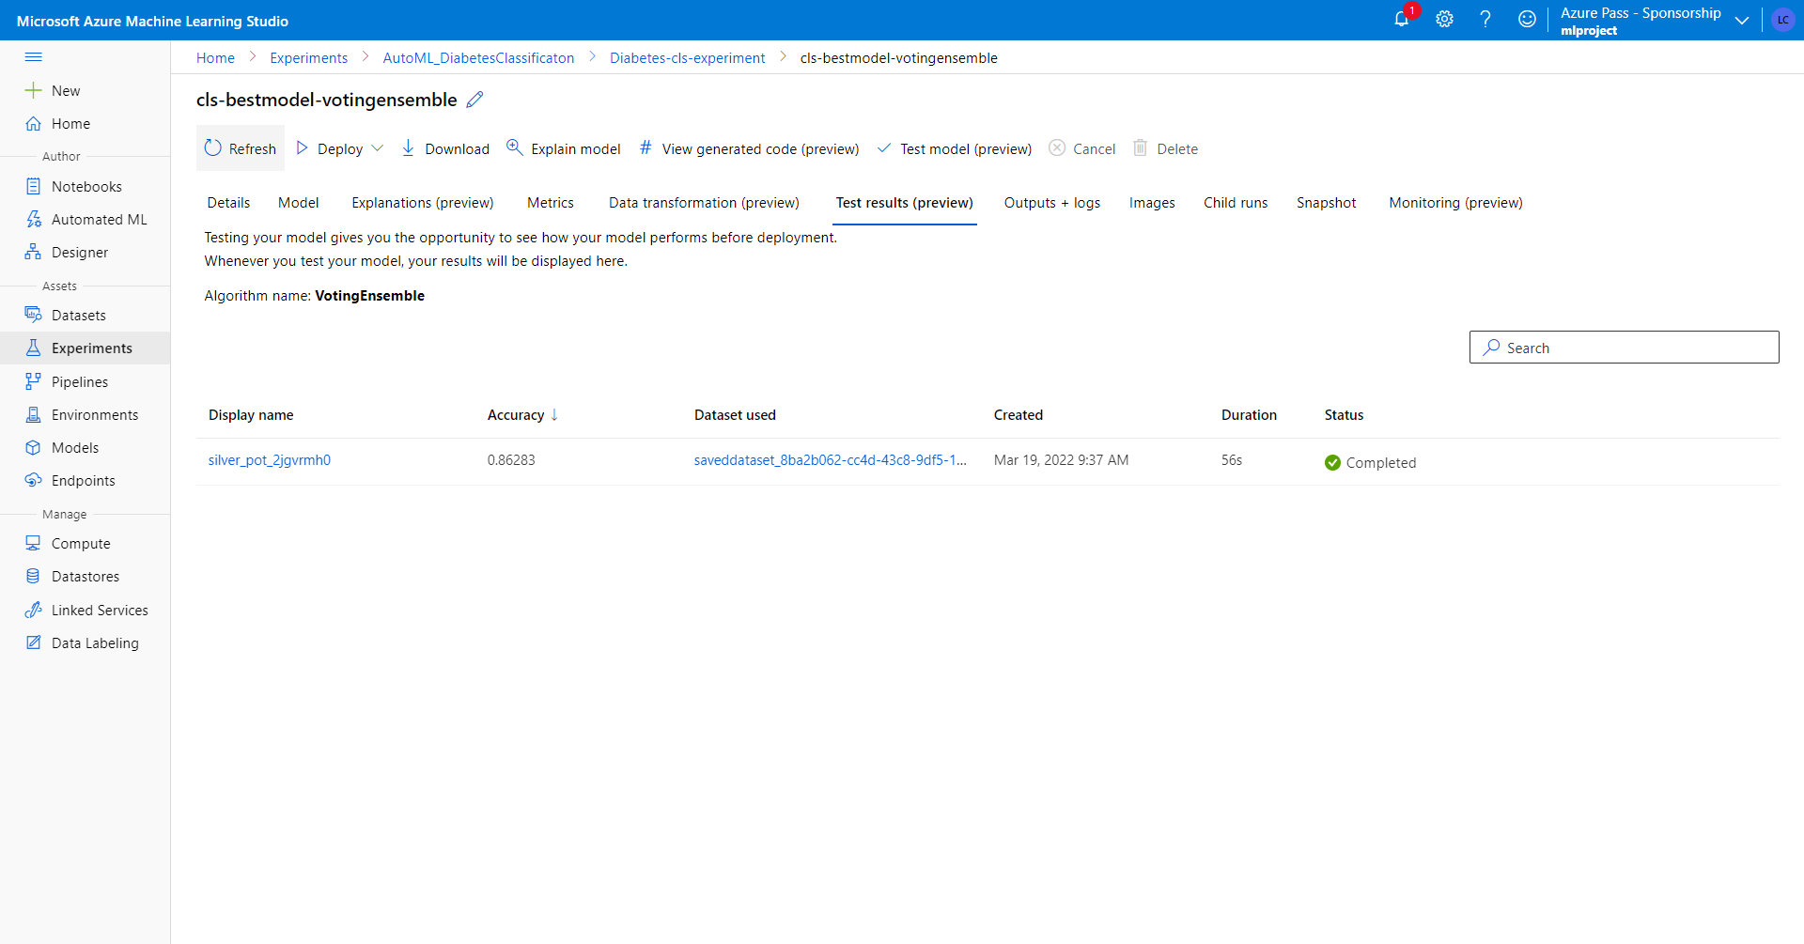
Test set experiment

Slide 13
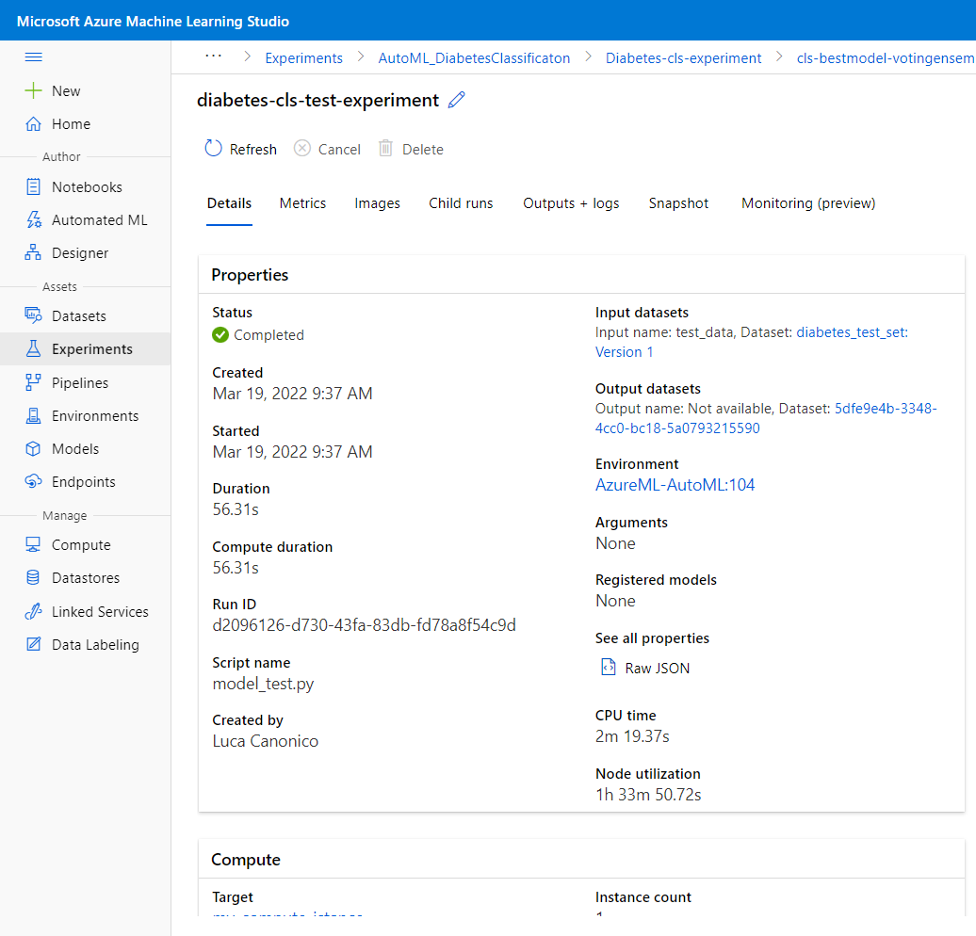
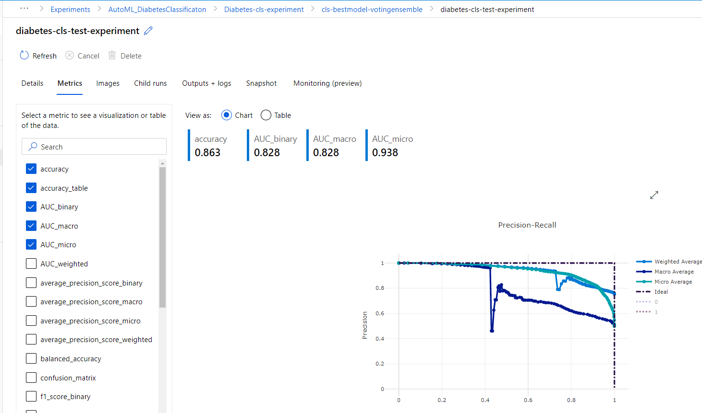
Rename the experiment on test data and see metrics

Slide 14
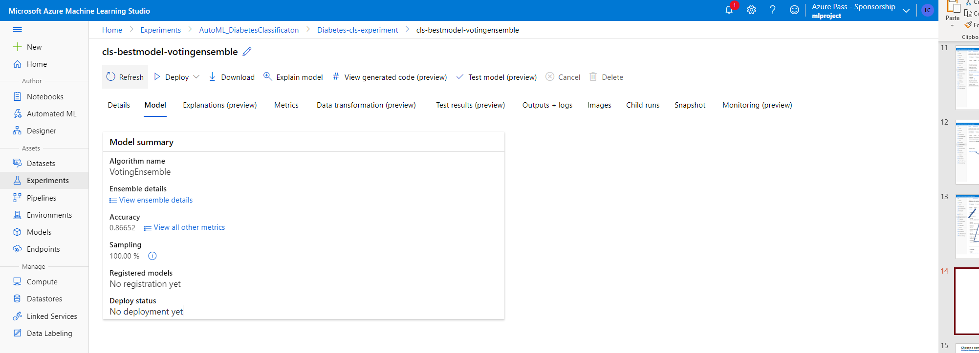
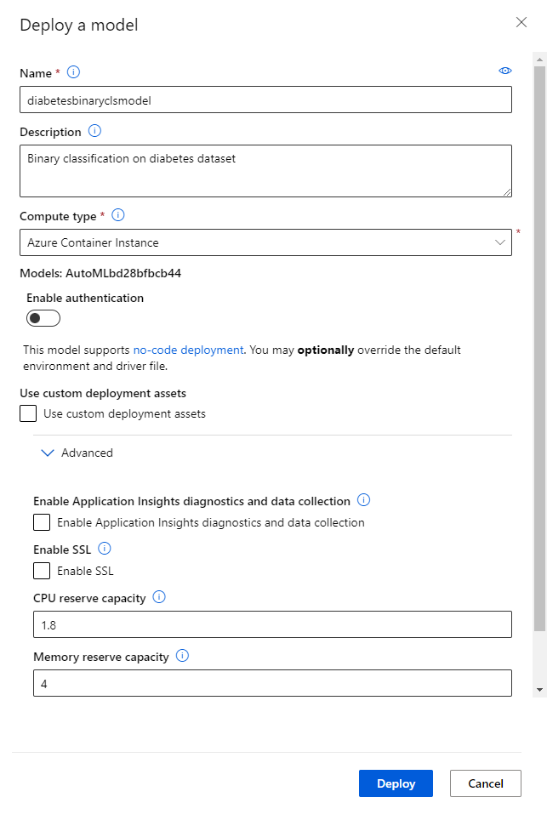
Go Back to your trained model and deploy the model to a web service; in the pop-up window that will appear:
define the name that will show under the Endpoints tab once your model is deployed
Choose a compute target

Slide 15
Choose a compute target
Official Documentation: Read more about choosing a compute target
Compute target | Used for | GPU support | FPGA support | Description
Local web service | Testing/debugging |  |  | Use for limited testing and troubleshooting. Hardware acceleration depends on use of libraries in the local system.
Azure Kubernetes Service (AKS) | Real-time inference Recommended for production workloads. | Yes (web service deployment) | Yes | Use for high-scale production deployments. Provides fast response time and autoscaling of the deployed service. Cluster autoscaling isn't supported through the Azure Machine Learning SDK. To change the nodes in the AKS cluster, use the UI for your AKS cluster in the Azure portal. Supported in the designer.
Azure Container Instances | Real-time inference Recommended for dev/test purposes only. |  |  | Use for low-scale CPU-based workloads that require less than 48 GB of RAM. Doesn't require you to manage a cluster. Supported in the designer.
Azure Machine Learning compute clusters | Batch inference | Yes (machine learning pipeline) |  | Run batch scoring on serverless compute. Supports normal and low-priority VMs. No support for real-time inference.
Azure Arc enabled Kubernetes | Real-time inference Batch inference | Yes | N/A | Run inferencing workloads on on-premise, cloud, and edge Kubernetes clusters managed in Azure Arc

Slide 16
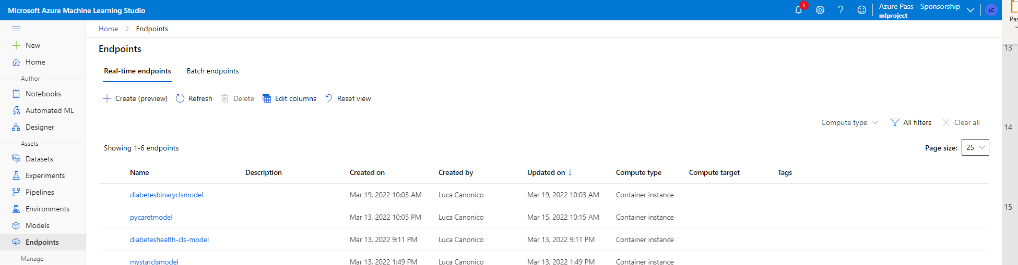
Now you can use it in Power BI report to go prediction on new data!

Slide 17
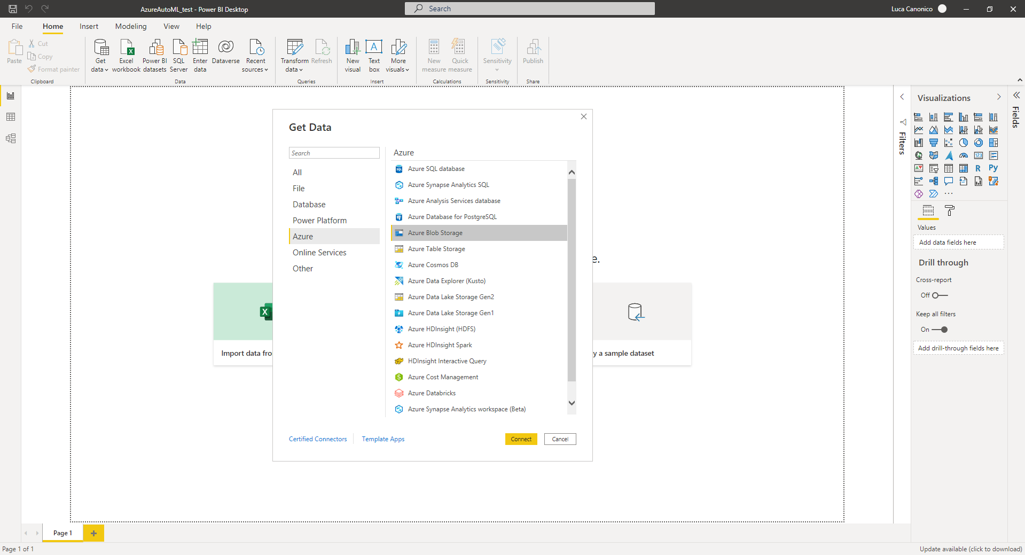
make prediction on new data stored in azure blob container

Slide 18
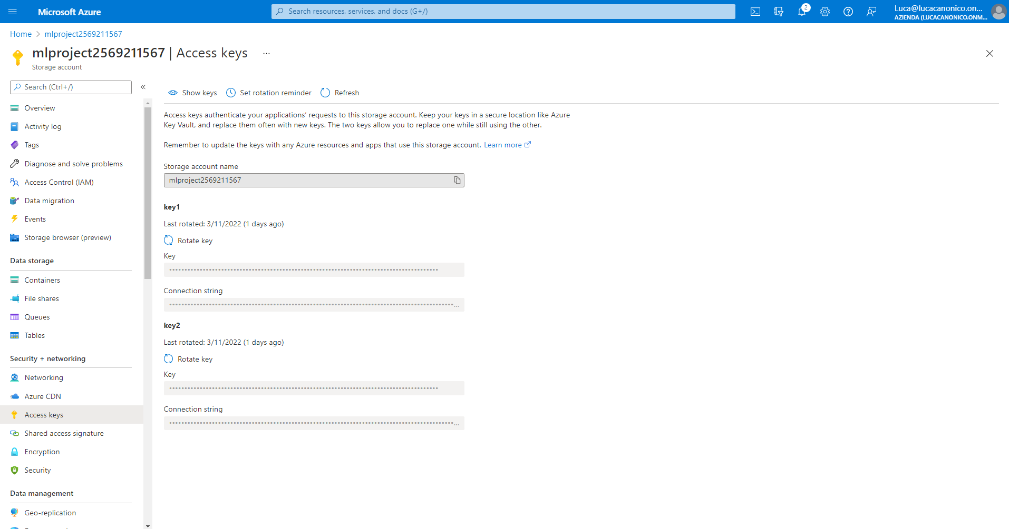
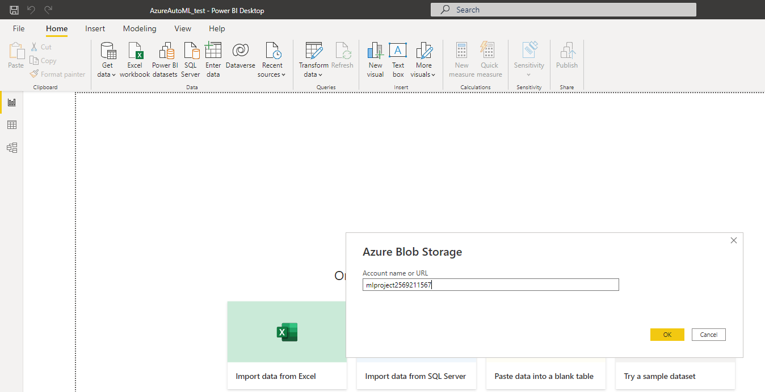
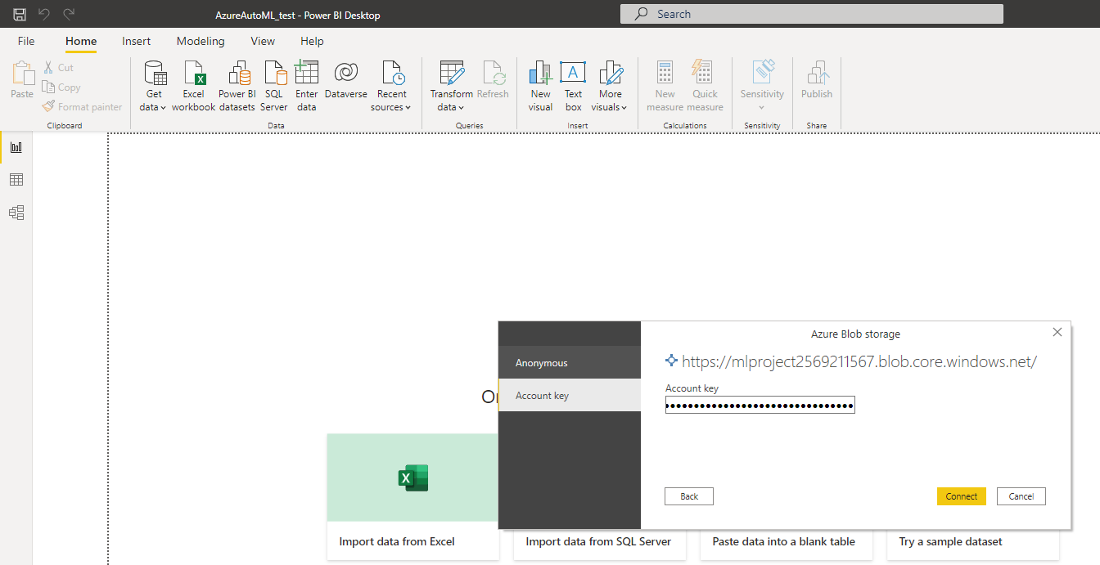
Go to your storage account > access keys and retrieve Storage account name and Key

Slide 19
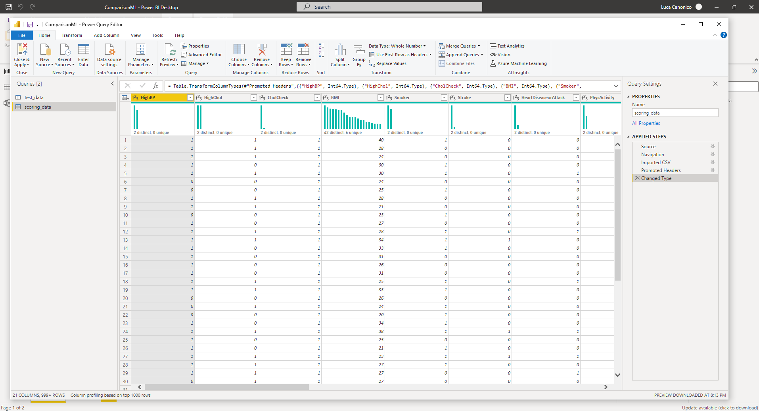
I’ve imported scoring_data (unlabeled data) on which make prediction and the test data used on Azure ML Studio to evaluate model after training

Slide 20
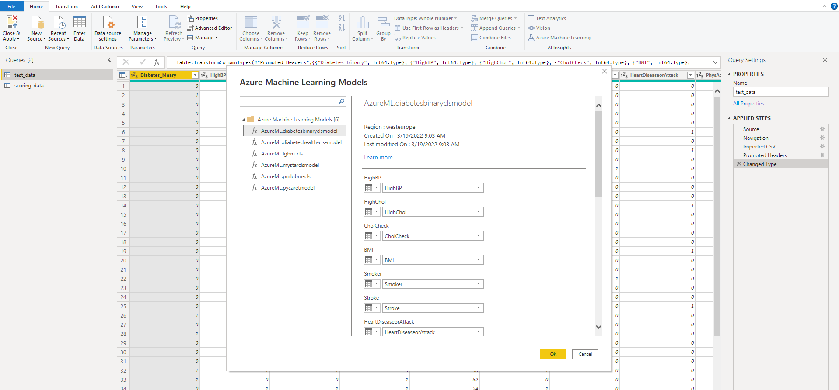

Slide 21
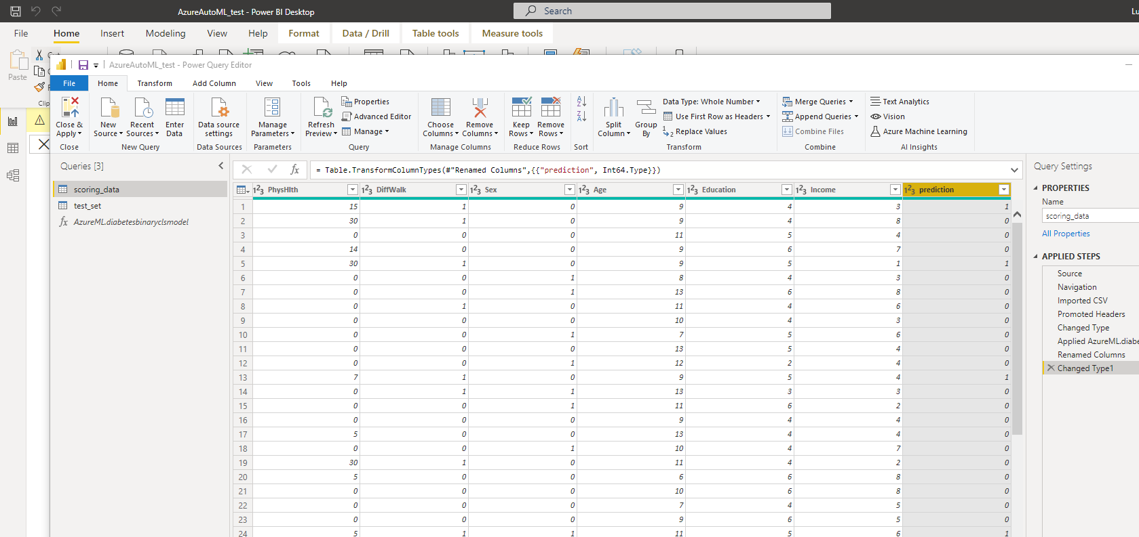
Check data type and rename column as prediction; apply the machine learning model also on the test_data and do the same operation; then close&apply PowerQueryEditor!
Uncheck ‘Include in report refresh’ option for test_set table.

Slide 22
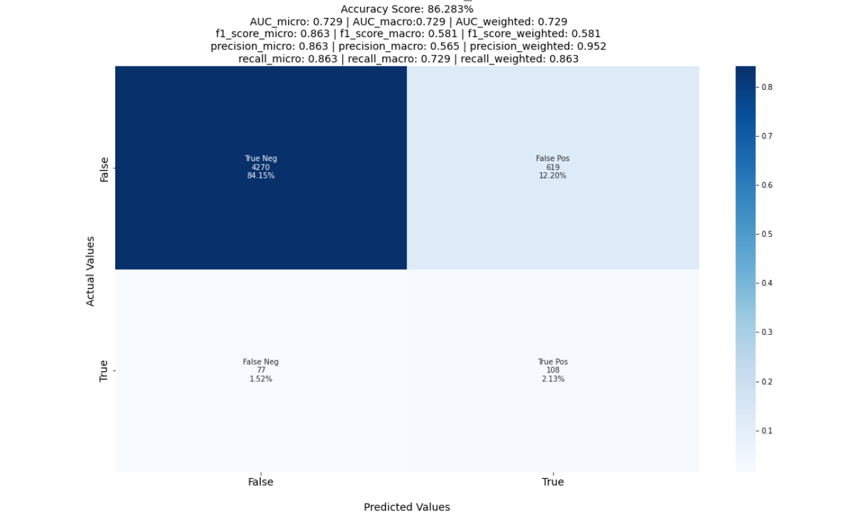
Python script visual

Slide 23
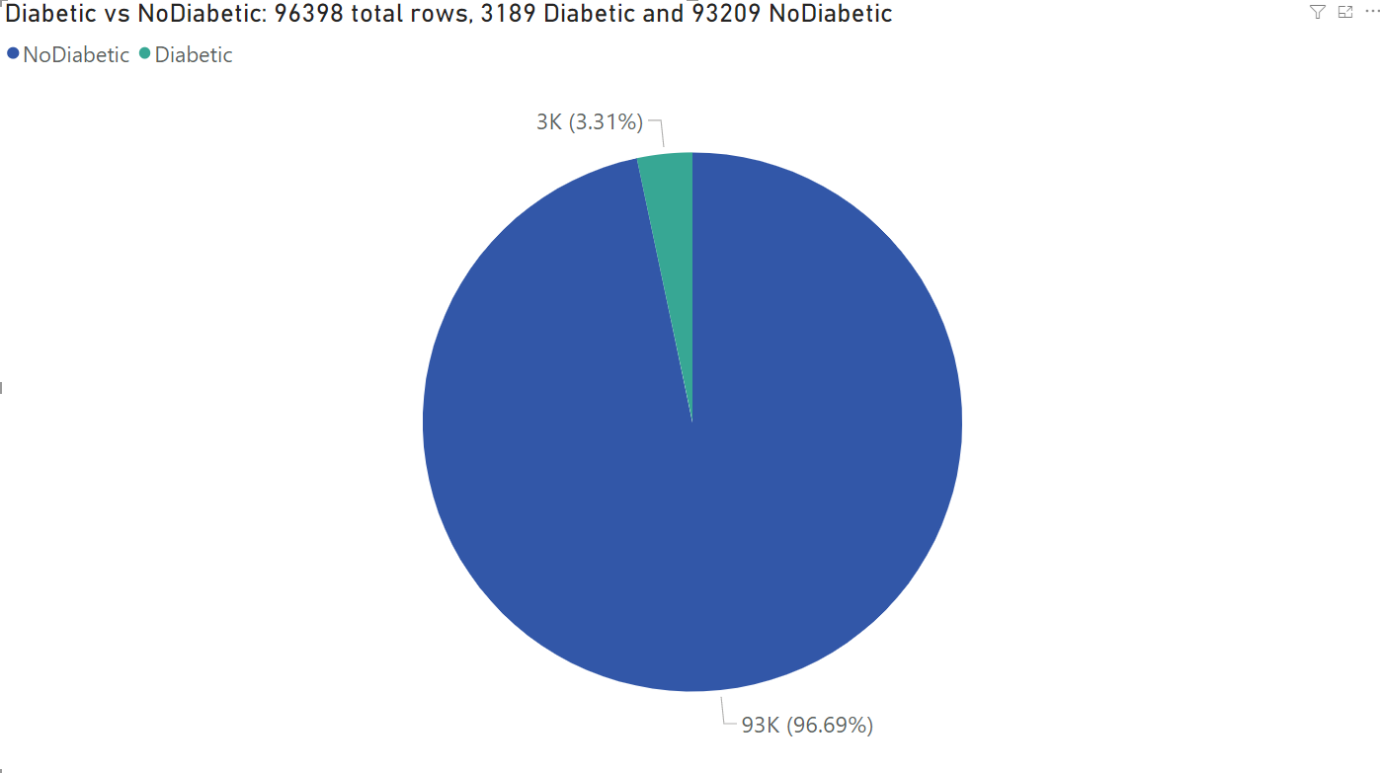
Pie Chart on new data

Slide 24
What is Azure Machine Learning studio?
Automated machine learning (AutoML) for dataflows enables business analysts to train, validate, and invoke Machine Learning (ML) models directly in Power BI. It includes a simple experience for creating a new ML model where analysts can use their dataflows to specify the input data for training the model. The service automatically extracts the most relevant features, selects an appropriate algorithm, and tunes and validates the ML model. After a model is trained, Power BI automatically generates a performance report that includes the results of the validation. The model can then be invoked on any new or updated data within the dataflow.
See Automated Machine Learning in Power BI Microsoft documentation.
Prerequisites
Power BI premium-per-user licenze or premium-per-capacity
Get started
Sing in to Power BI
Select your workspace

